Slide 1
5 Layer Processing

Slide 2
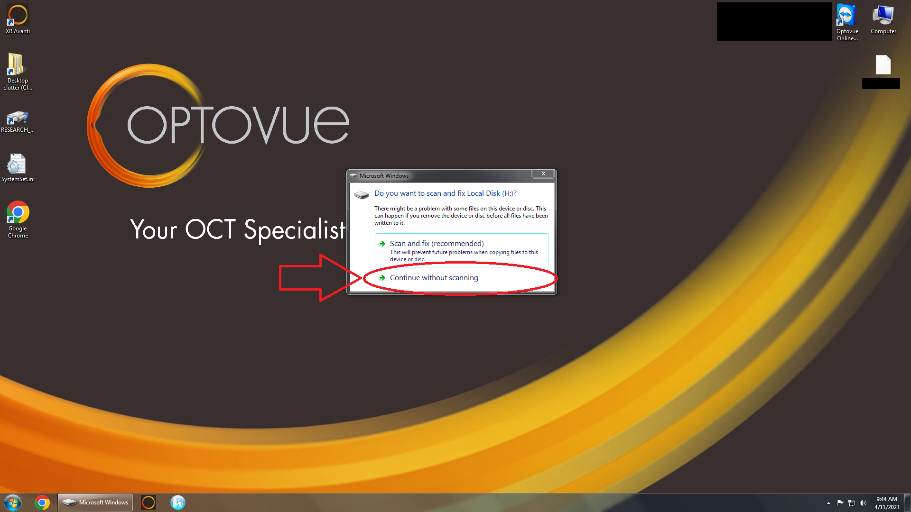
Insert Hard Drive into Computer
To begin exporting and processing the data you have to start by inserting the external hard drive( that can be found in the cabinet with the revive binder) into the Optovue Avanti Computer. After inserting you will be prompted by the image below: Click Continue without Scanning. Another windows should appear here you can click Open Folder to View Files.

Slide 3
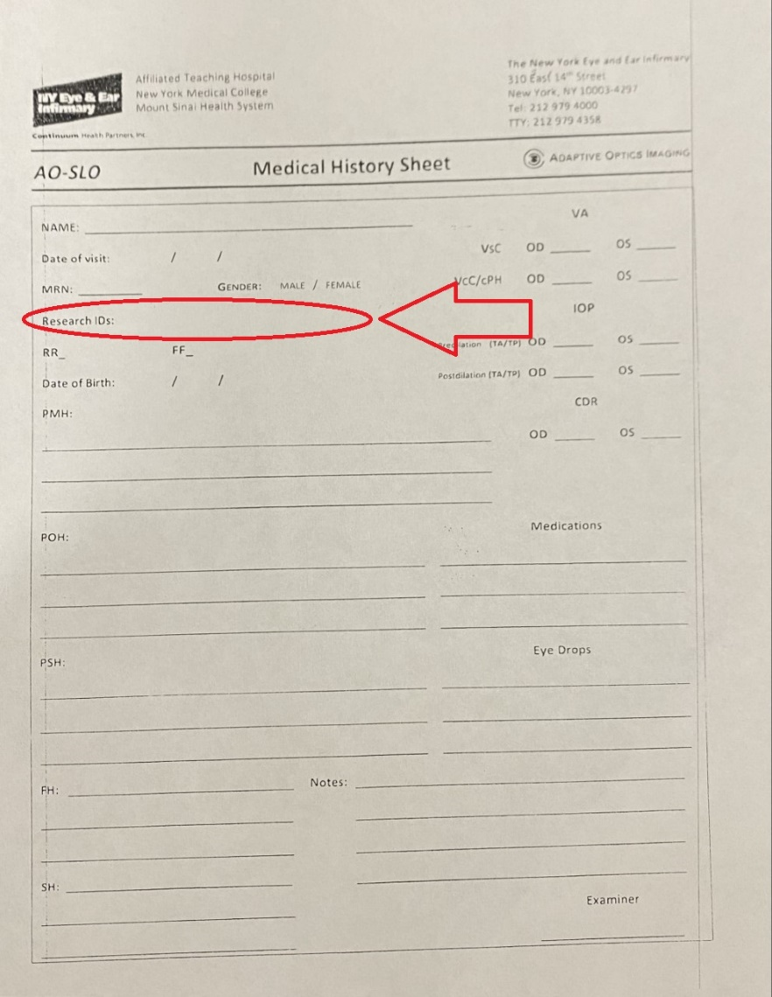
Where would you like to export?
Locate where you would like to export the data. Create a folder with the name being the Research ID that will identify the patient. You can easily find the Research ID on the Medical History Sheet. As shown on the right:

Slide 4
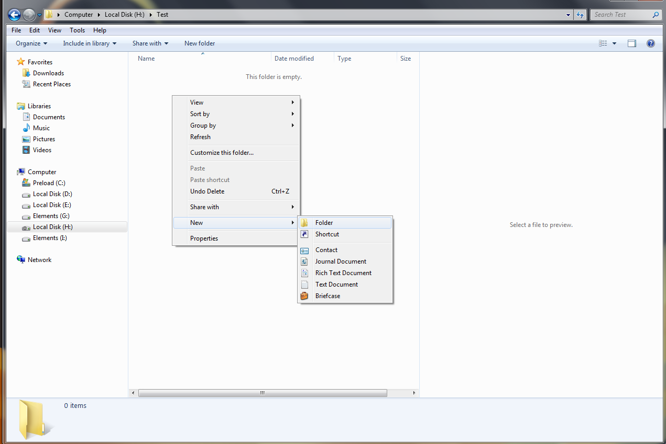
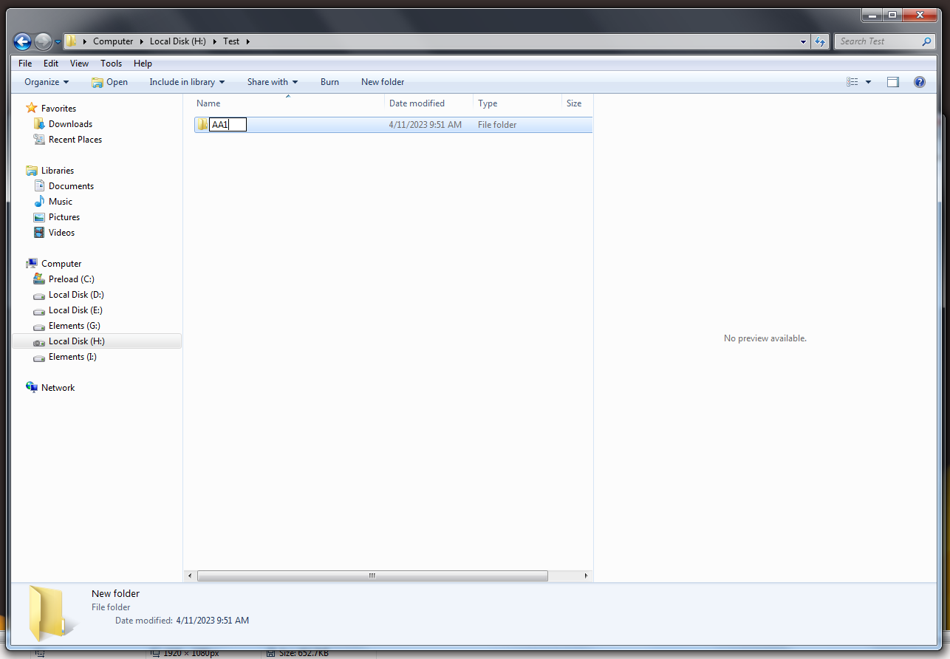
Once you have your Research ID create a folder in the hard drive
We will name ours AA1

Slide 5
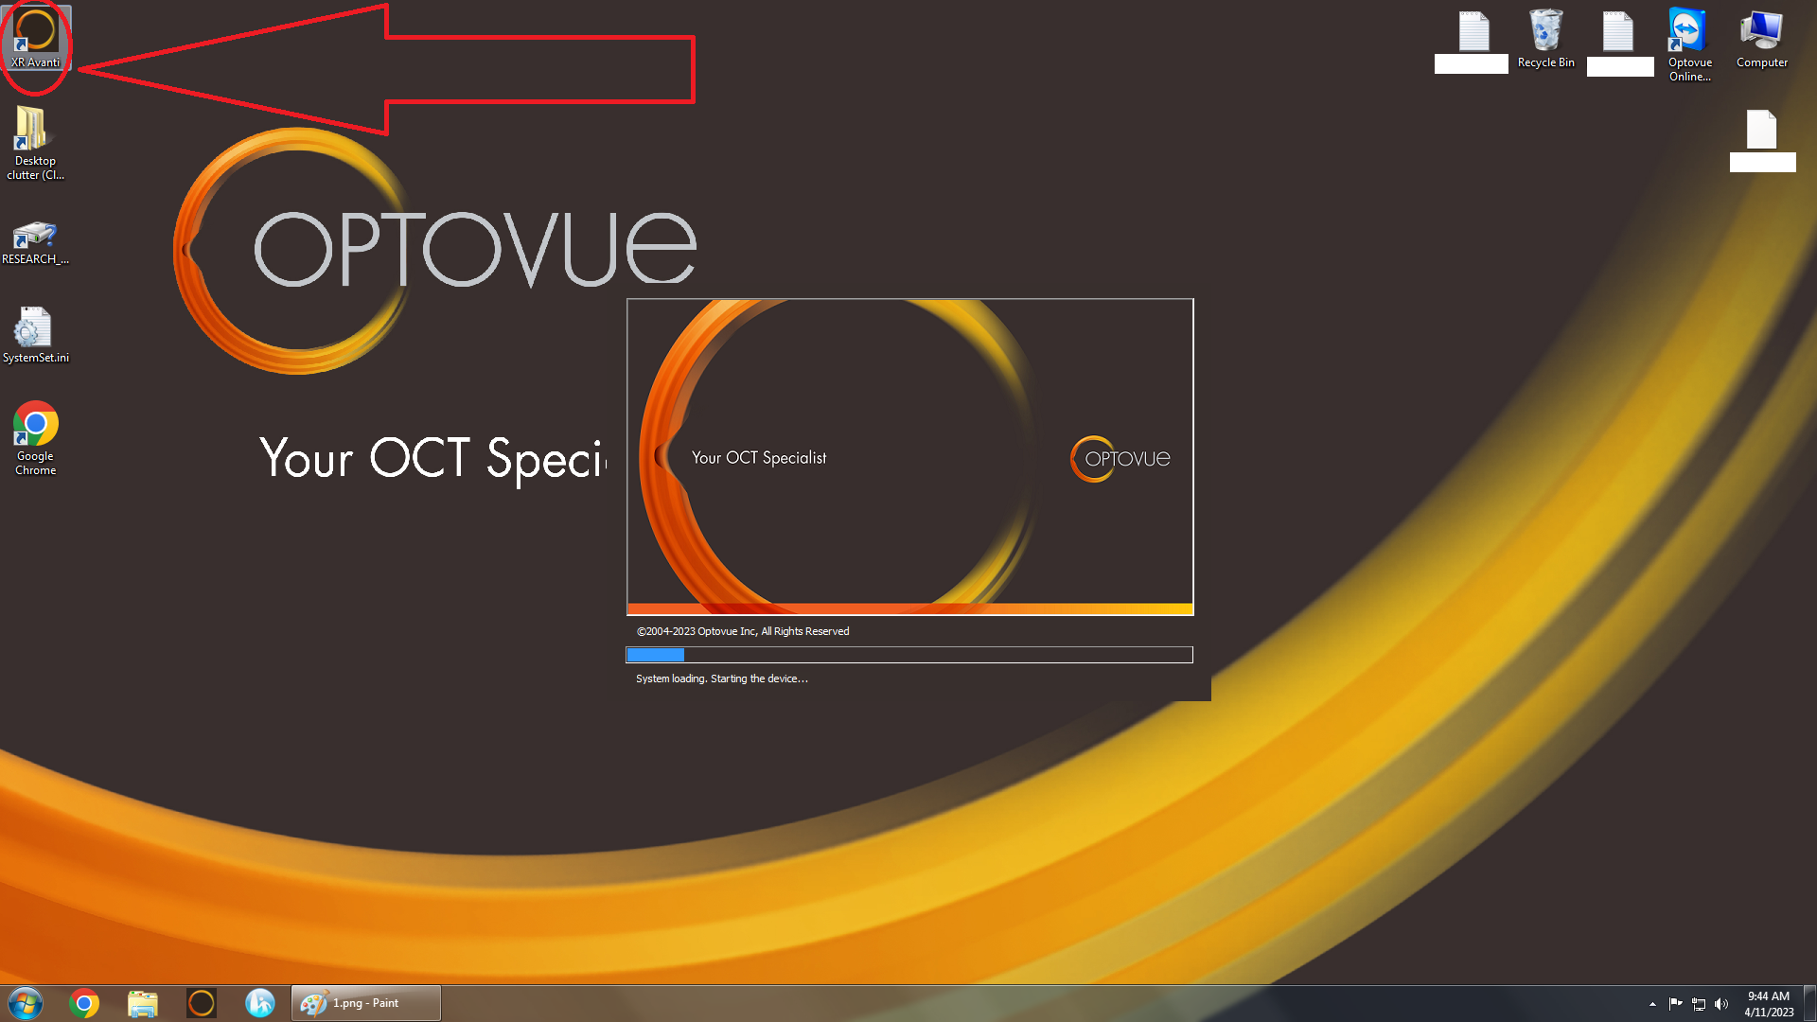
Open XR Avanti

Slide 6
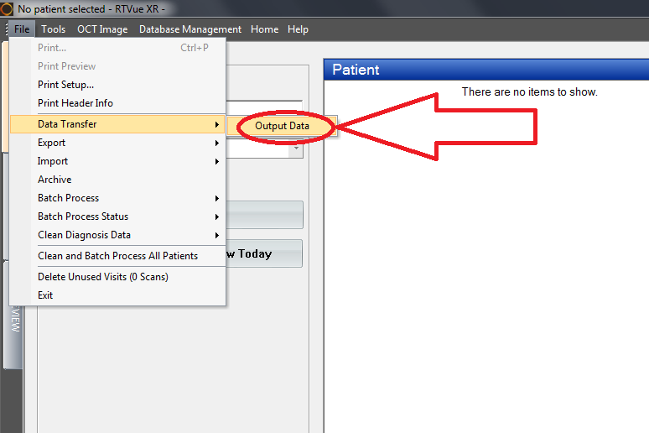
Once opened. CLICK FILE-> DATA TRANSFER->OUTPUT DATA.

Slide 7
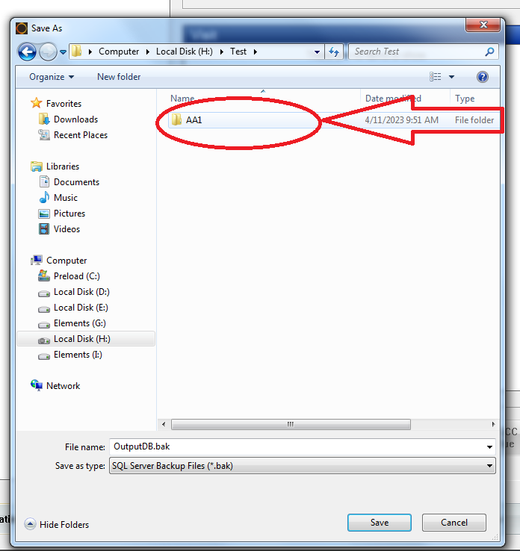
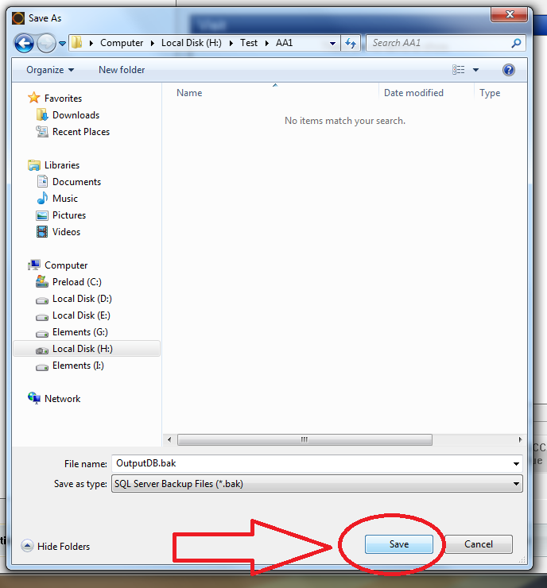
A new window should open asking where to save. Locate and open the folder we created at the start. Open the folder and press “SAVE”.

Slide 8
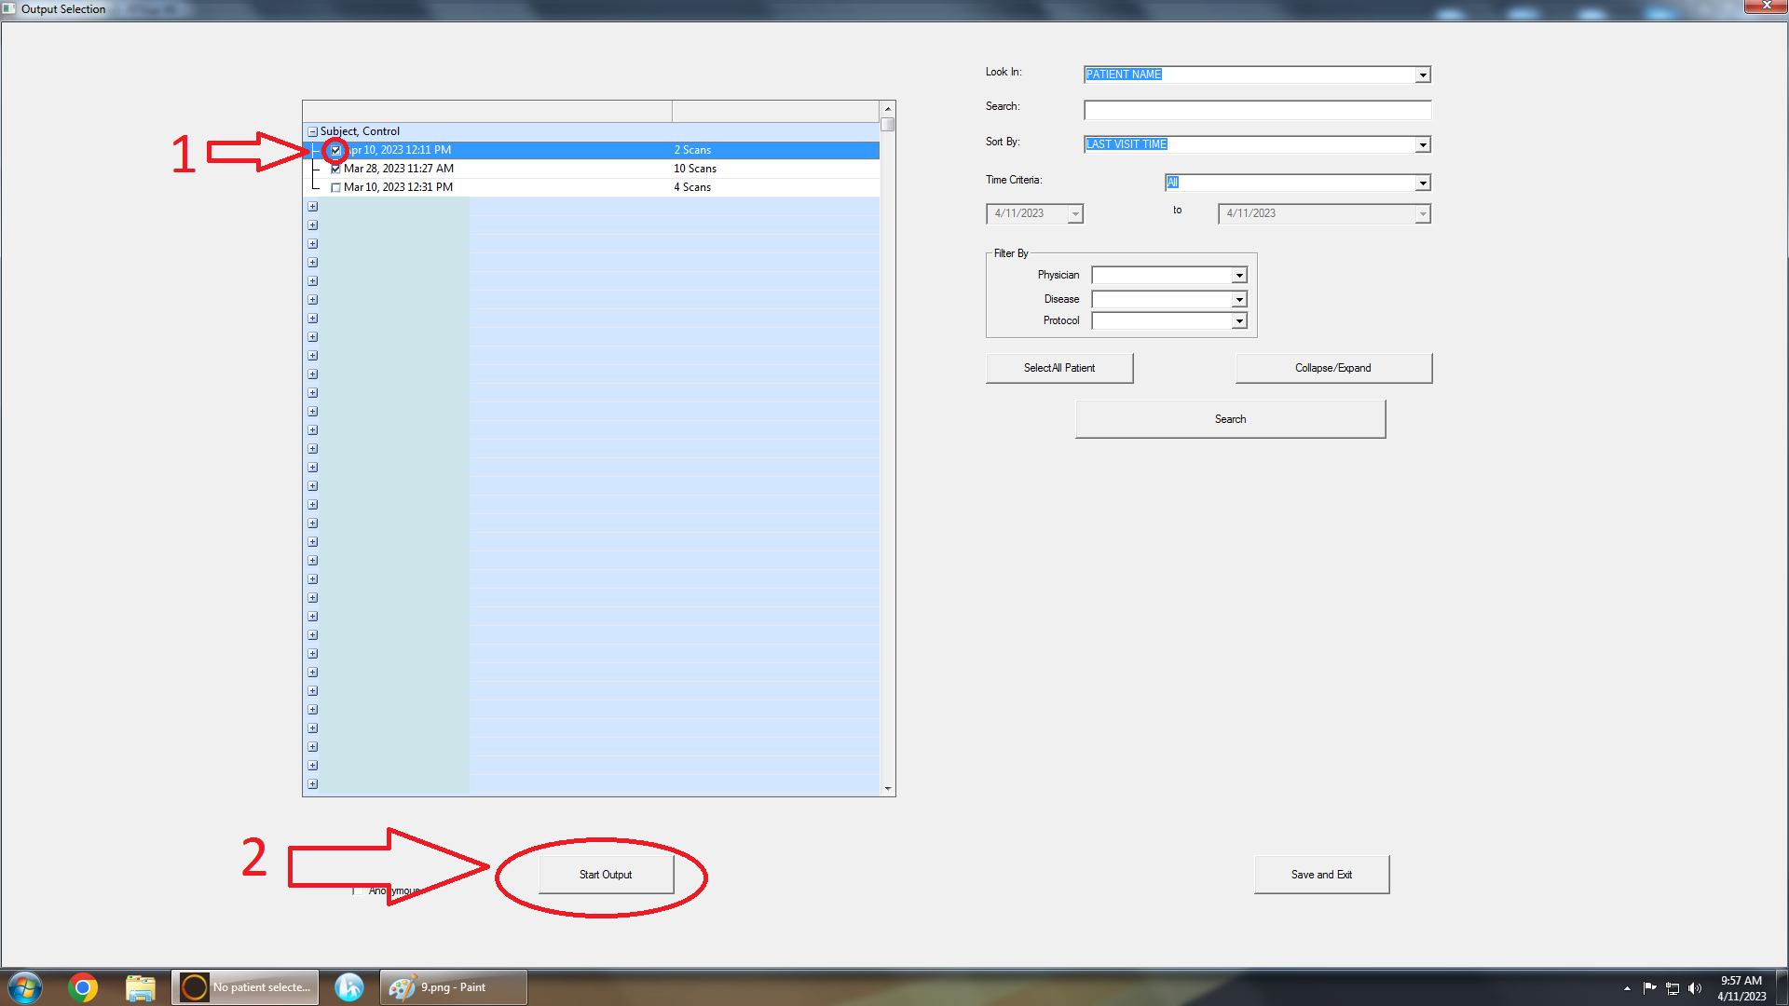
The program will ask which scan session to export choose the session by checking the session on the left panel. Then Click “START OUTPUT”.

Slide 9
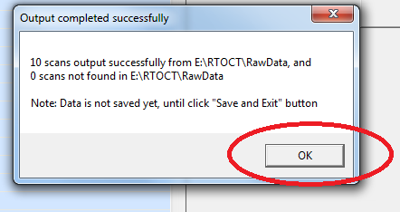
A window should open like below. CLICK “OK”. (The number of scans will vary in each export depending on the number of scans taken during the imaging session)

Slide 10
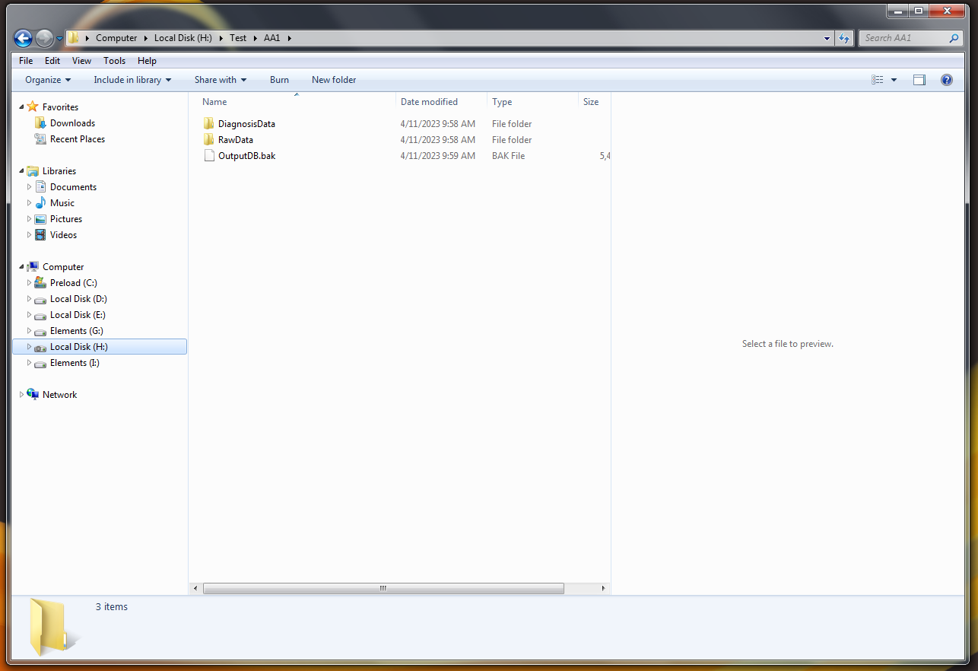
Check to see if the data is where it's supposed to be. You should have a folder with files like below.

Slide 11
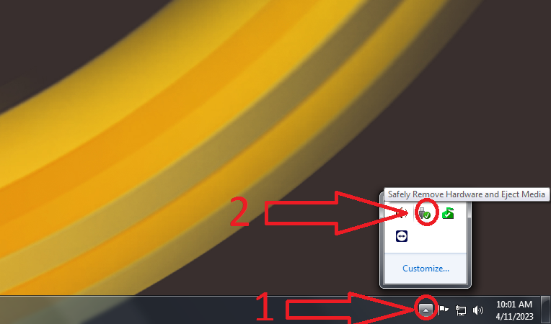
Close XR AVANTI and all other windows. Click the more button on the taskbar and then click “SAFELY REMOVE AND EJECT MEDIA”. Choose your drive. Once it prompts that you can remove the drive, you can remove your drive.

Slide 12
IMPORTING AND 5 LAYER
Insert the drive with the exported data from the Optovue into the ReVue Station (second computer from the left in the reception area of Suite 500). Click Continue without scanning and close the following window.
To get ready to import data we will first take a little tangent and find a place to hold the data while we work on it.
So where would you like the unprocessed data?
For now I'll use a test folder. But you do you and choose the folder that was created to hold the unprocessed data.

Slide 13
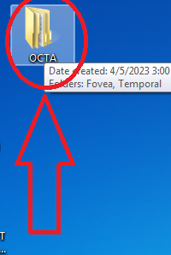
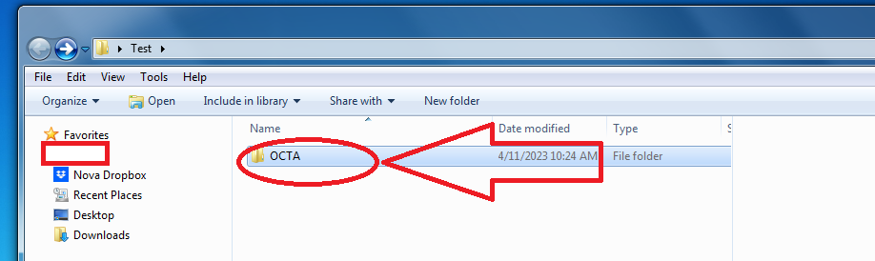
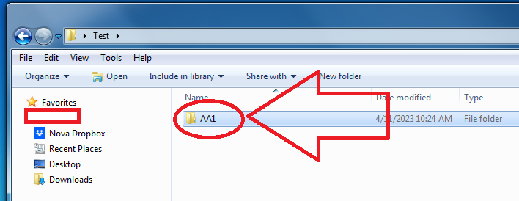
Locate the OCTA folder on the desktop. This will be used to make life easier (no promises) in the future. “Copy” the folder and “Paste” it where you want your data to be. Rename the Folder to the RESEARCH ID we used when exporting. So in our case, we’ll have a folder in the test folder named AA1.

Slide 14
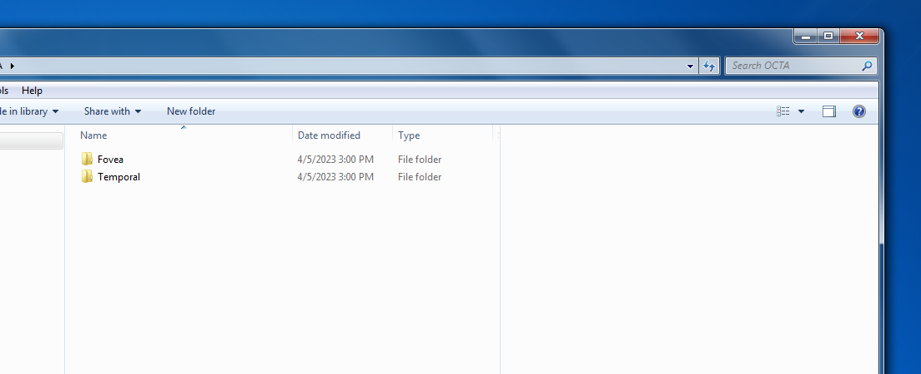
You should have a folder named the RESEARCH ID(AA1). And in that folder should be two folders one FOVEA and one TEMPORAL. These will be used in the future. You can close the window and we will start importing the data.

Slide 15
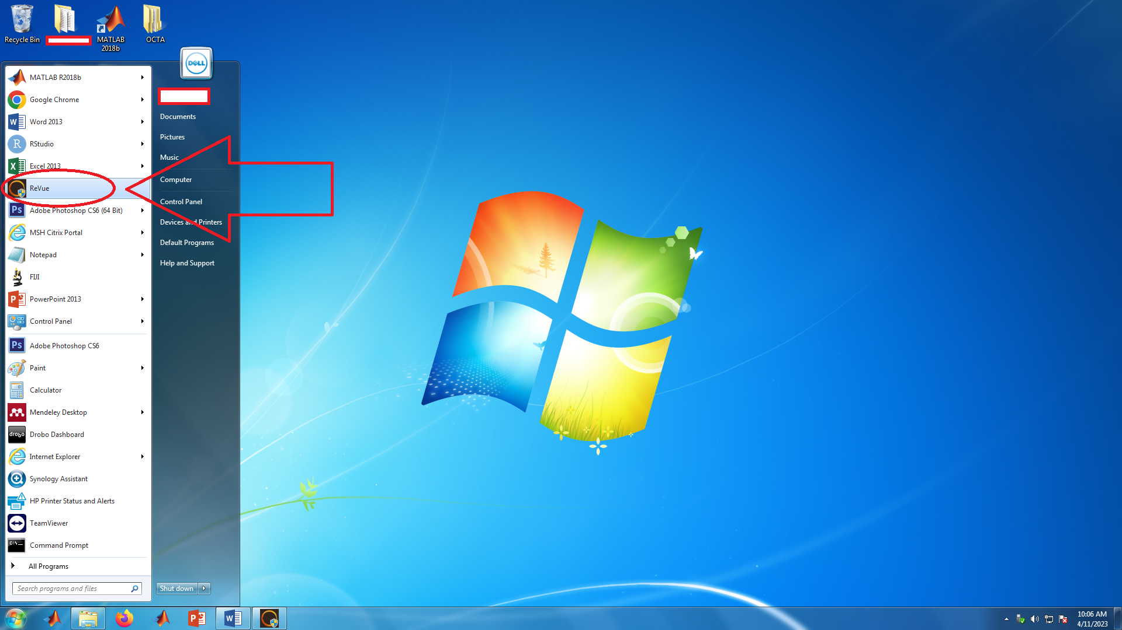
OPEN REVUE application found in the start bar.

Slide 16
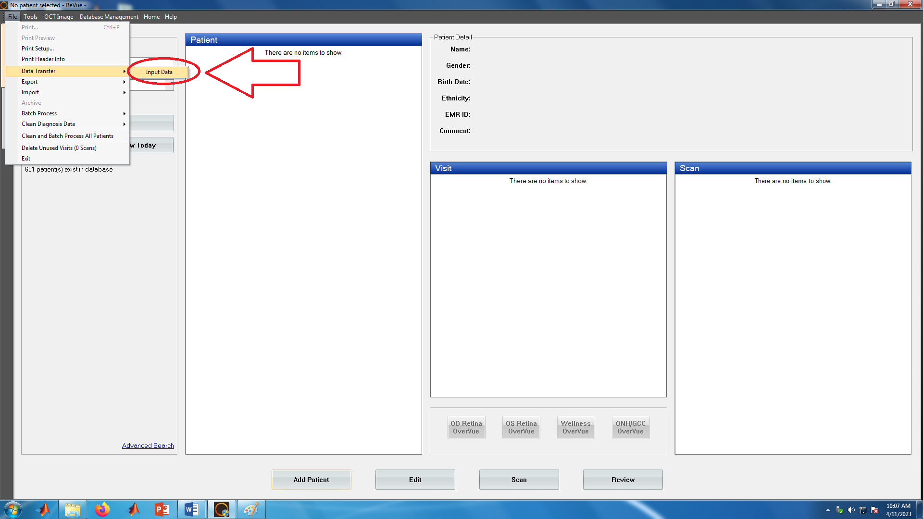
Inputting Data
Click FILE-> DATA TRANSFER-> INPUT DATA

Slide 17
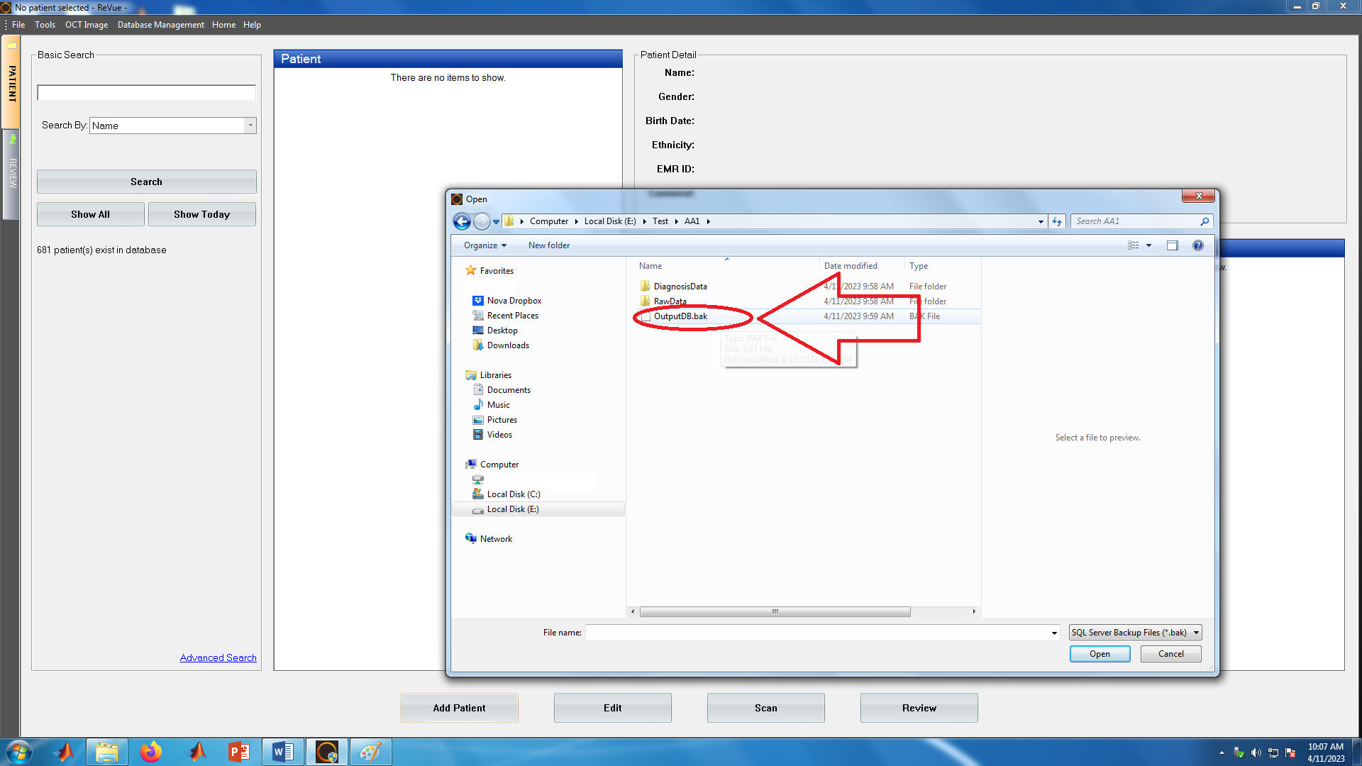
In the prompted window open the folder containing the data we exported into our hard drive. Click on the OutputDB.bak File

Slide 18
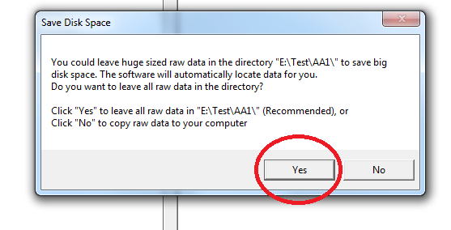
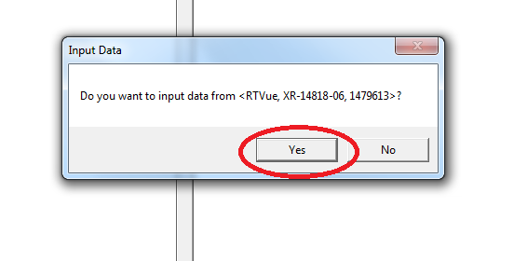
A window will appear. Click “YES”. Another window will prompt asking to input data click “YES” again.

Slide 19
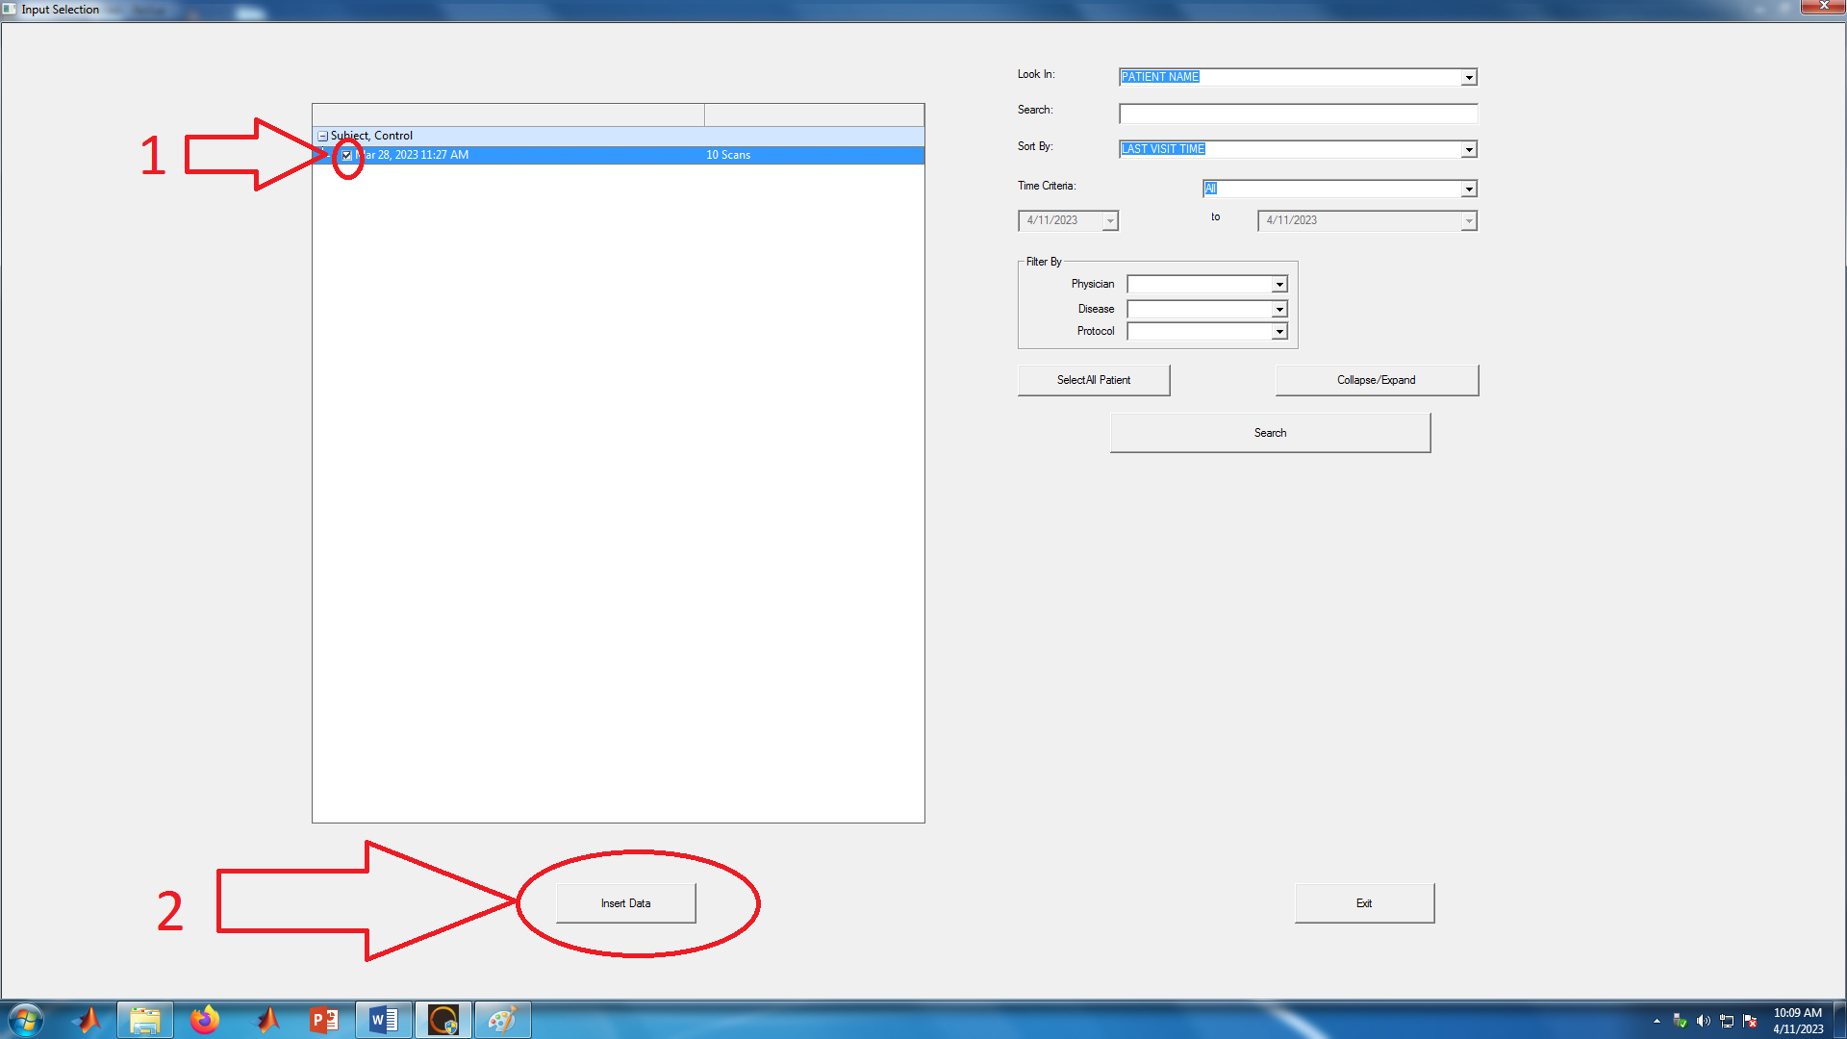
Select the session you would like to import by clicking the check mark on the left of the date. Then Click “INSERT DATA”.

Slide 20
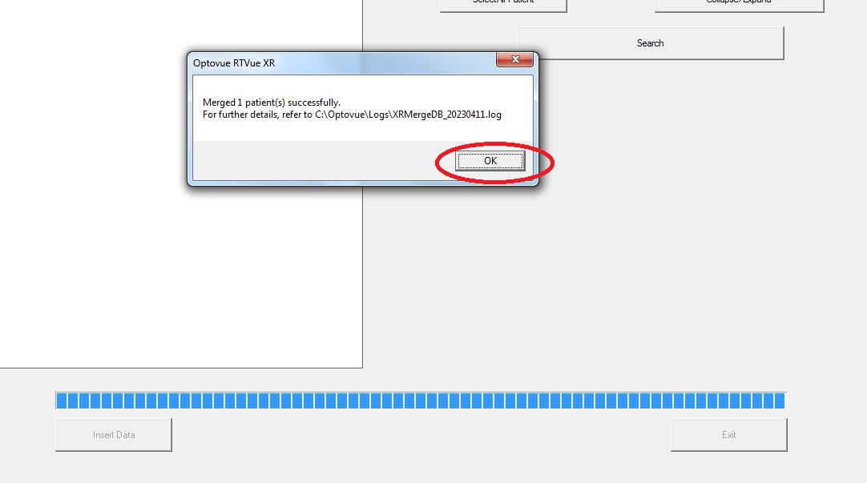
A new window will prompt merging successful . Click “OK”

Slide 21
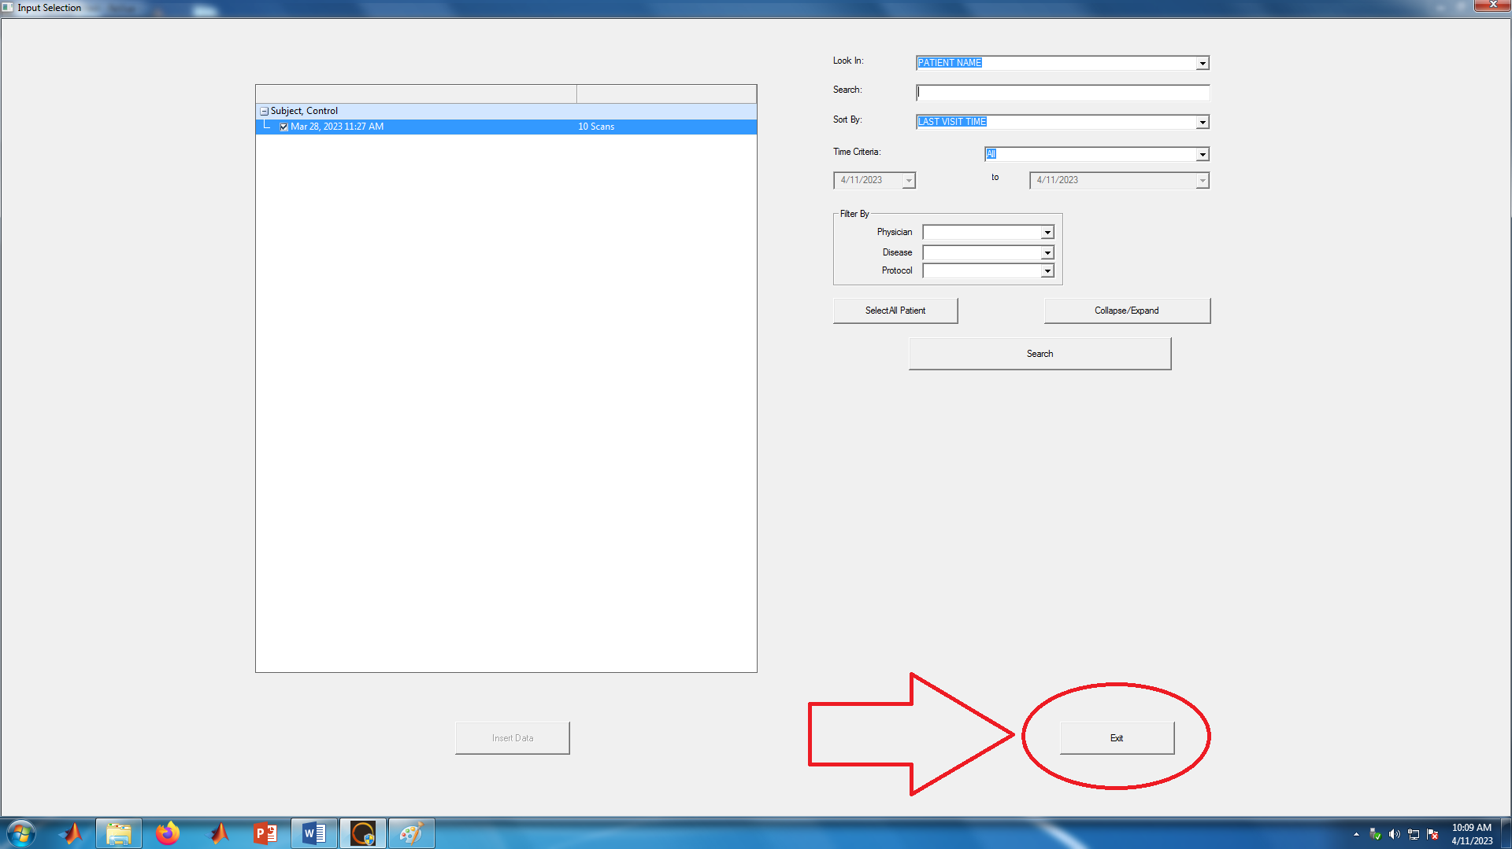
Click “Exit”

Slide 22
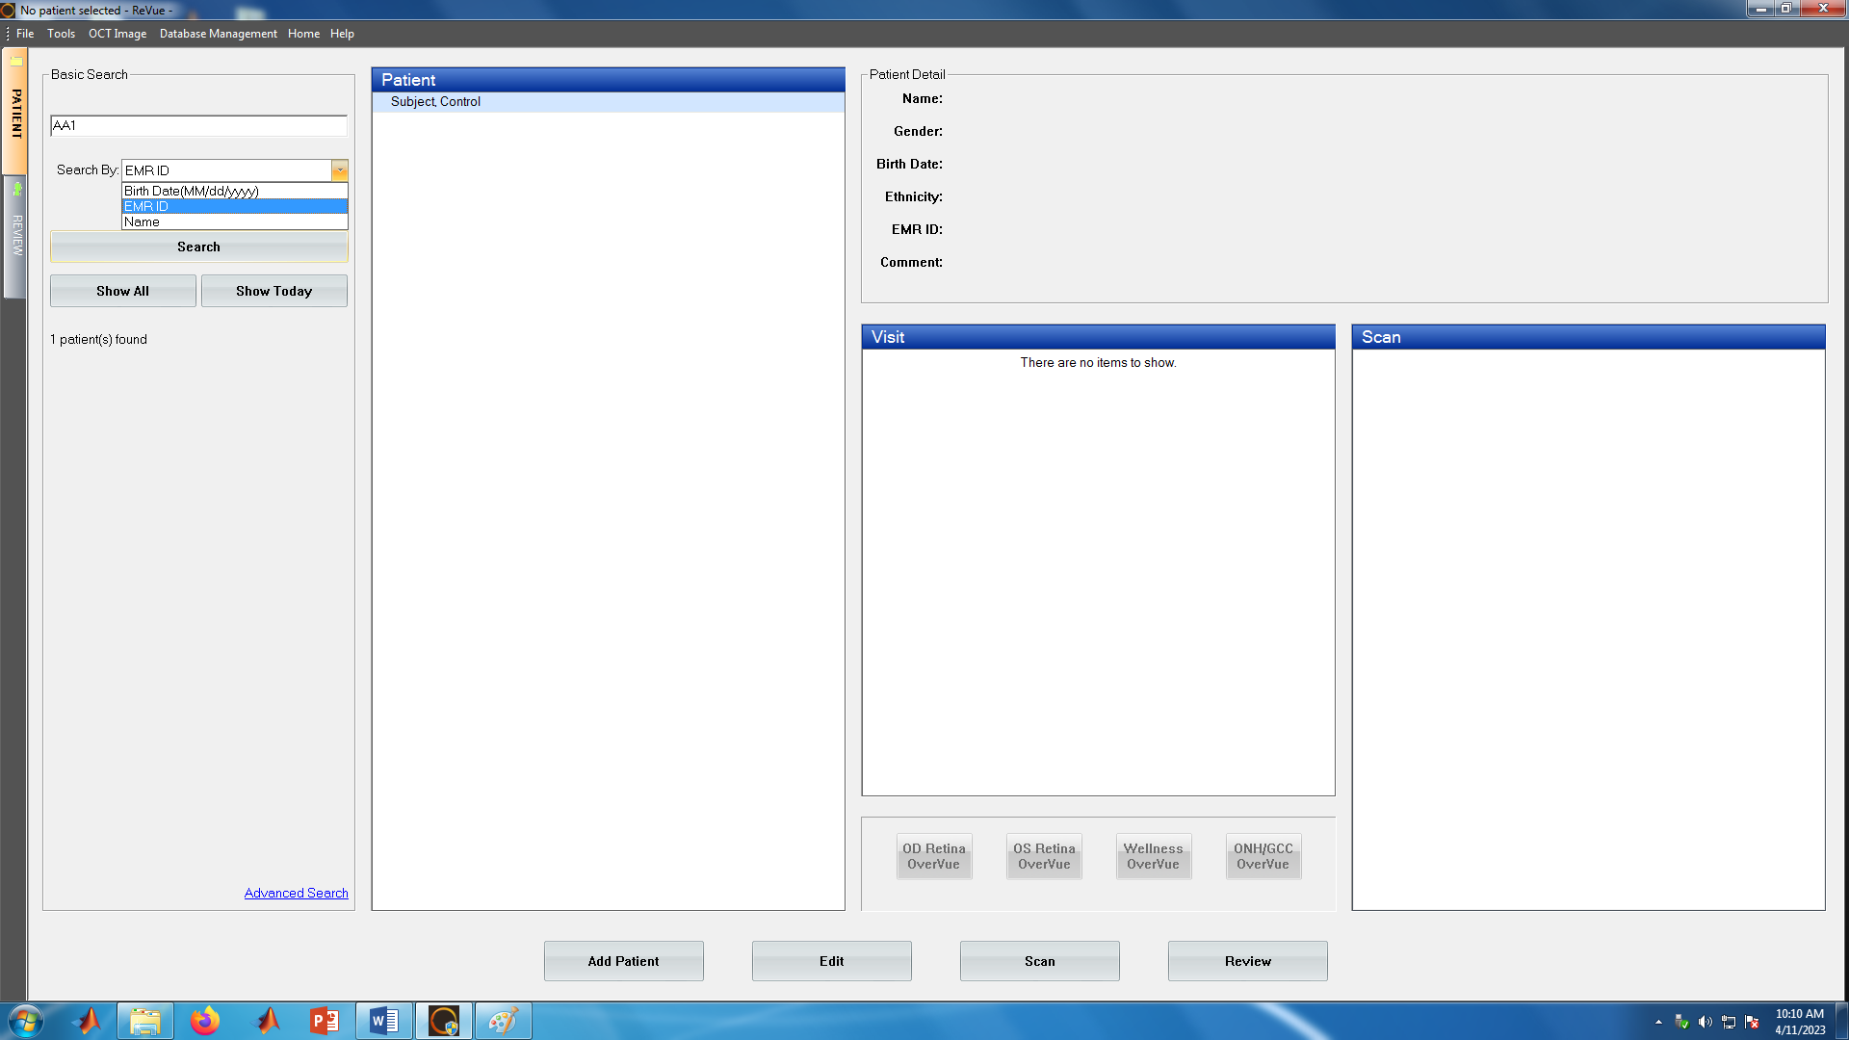
The window should appear like below. Locate the subject data you would like to work on by entering either NAME, Date of Birth, or EMR ID and clicking “Search”.

Slide 23
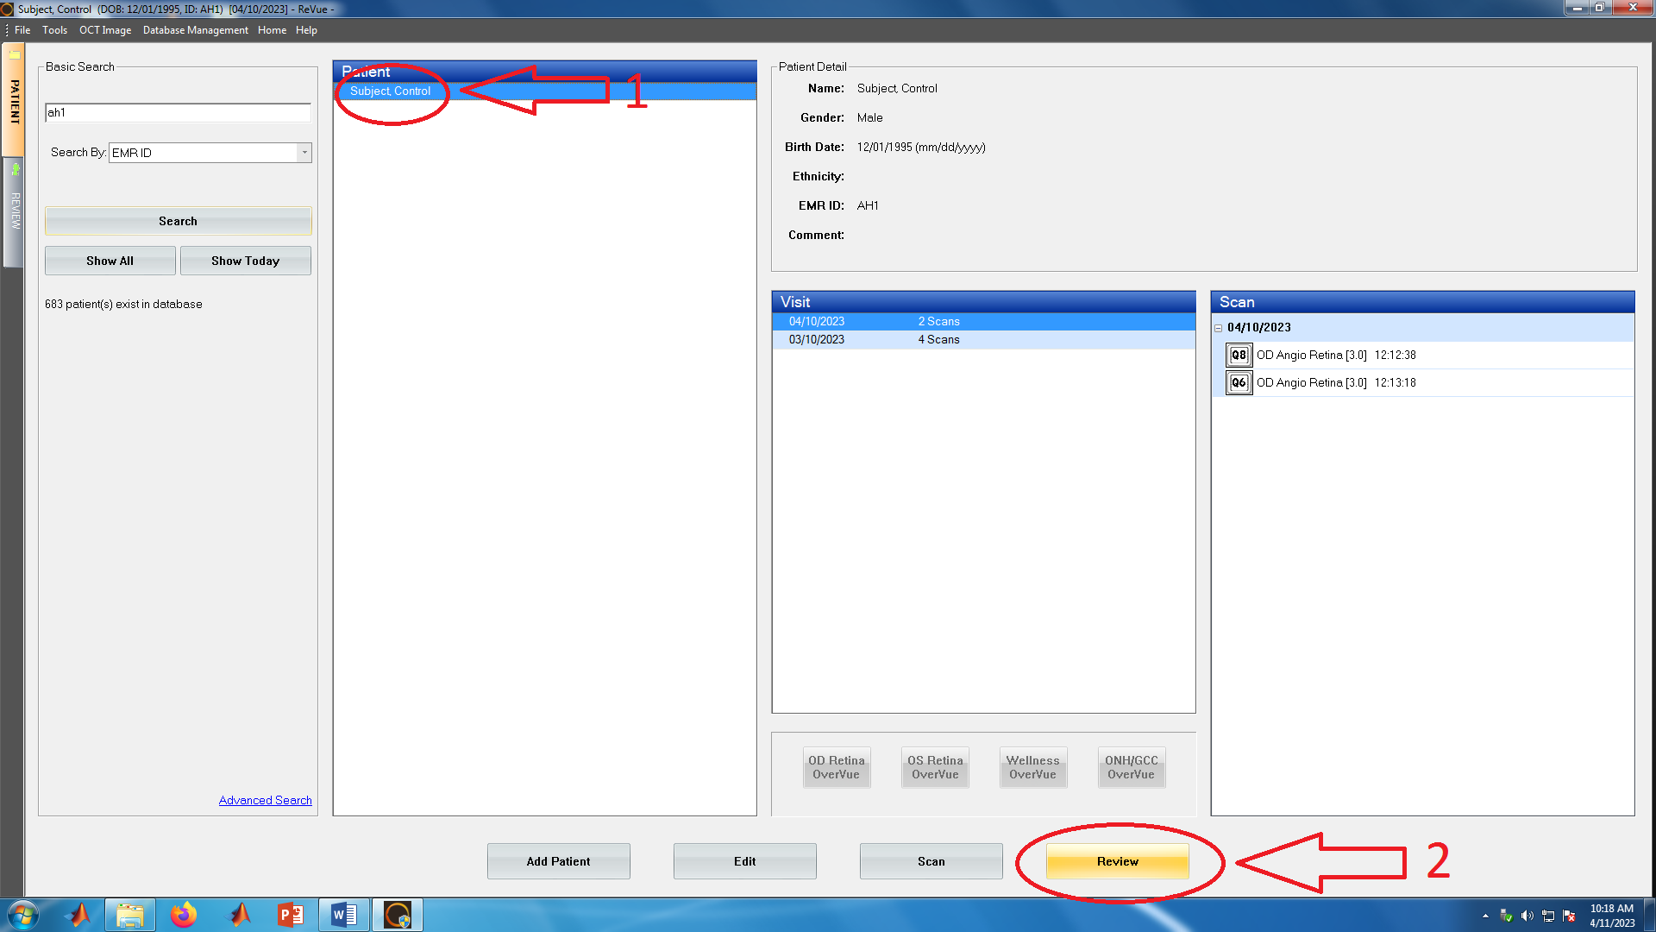
Choose the subject and session And click “Review”

Slide 24
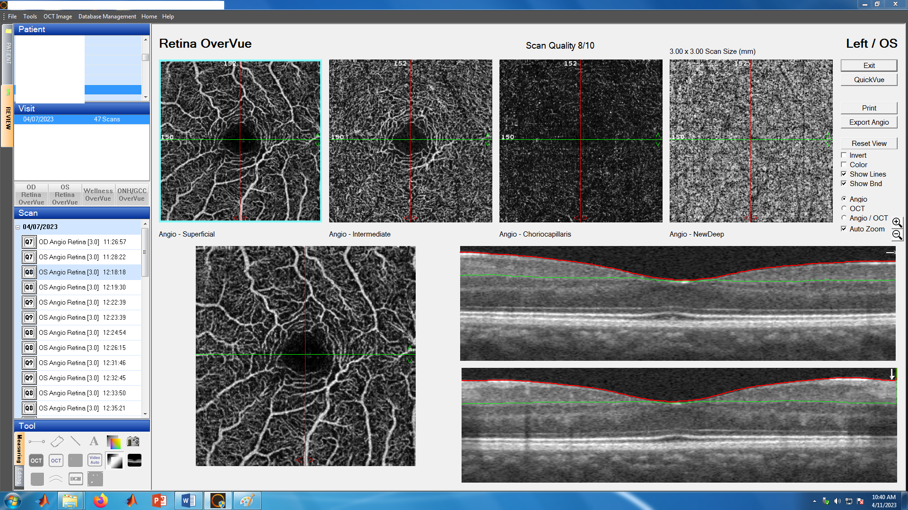
If this is the first visit, you will have two control scans done before dilation. These scans won’t be processed. Even though we have a total of 47 scans, starting with the third scan we will have 45 scans that will be processed. Click the third scan. You should have a window similar to this.

Slide 25
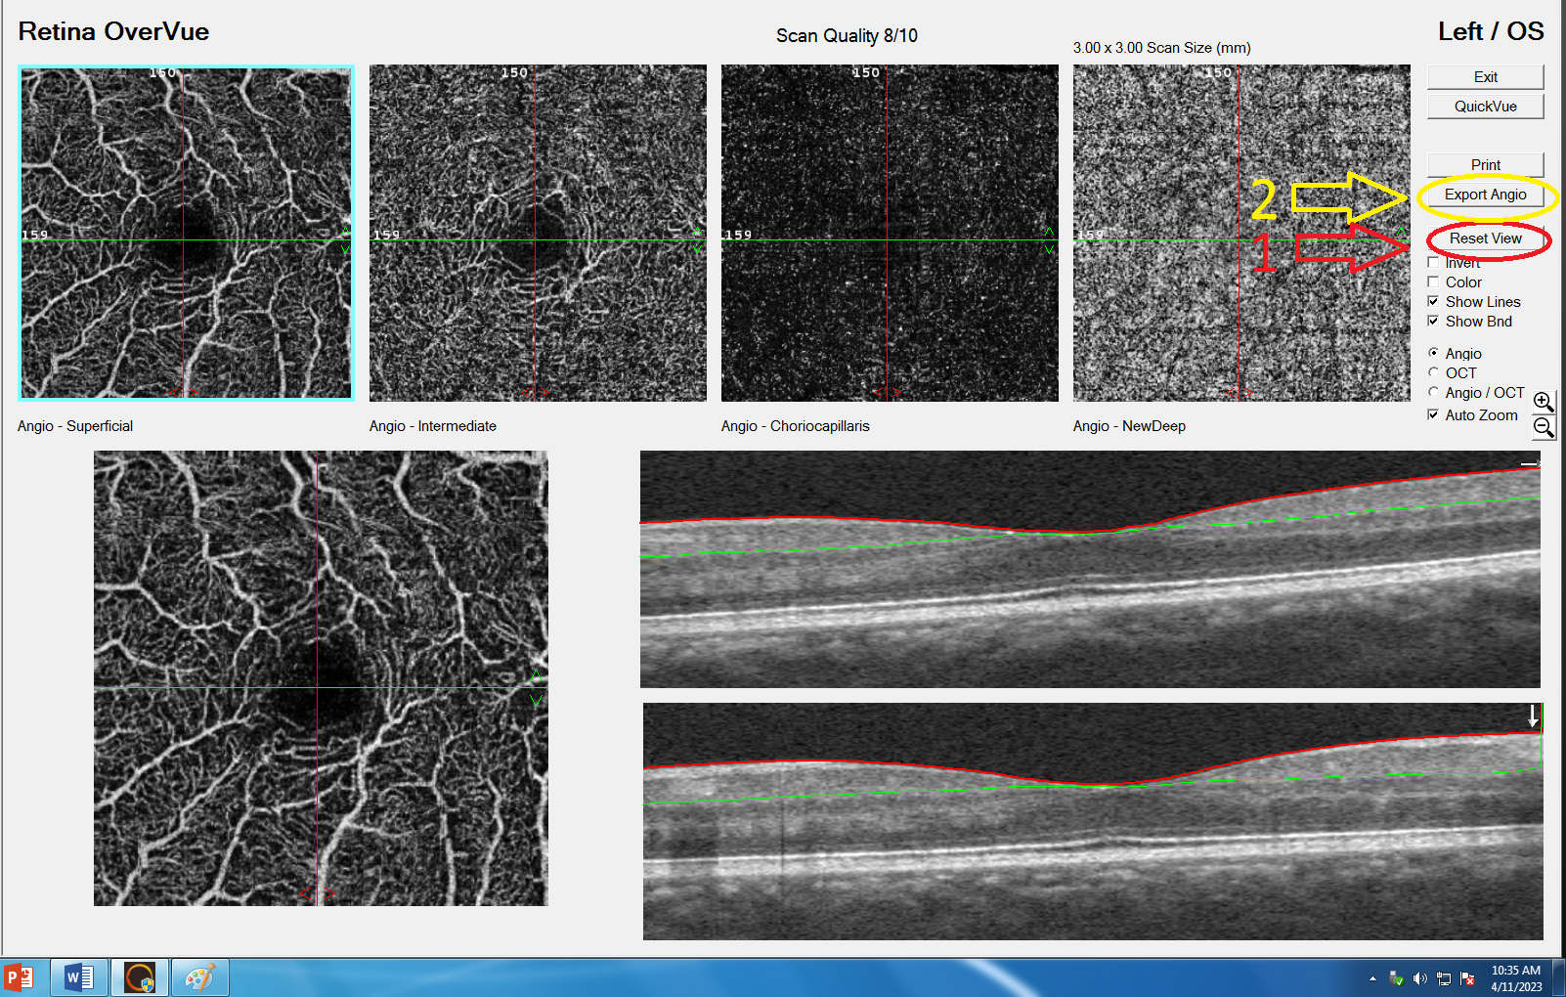
Click “RESET VIEW” AND THEN “EXPORT ANGIO”.

Slide 26
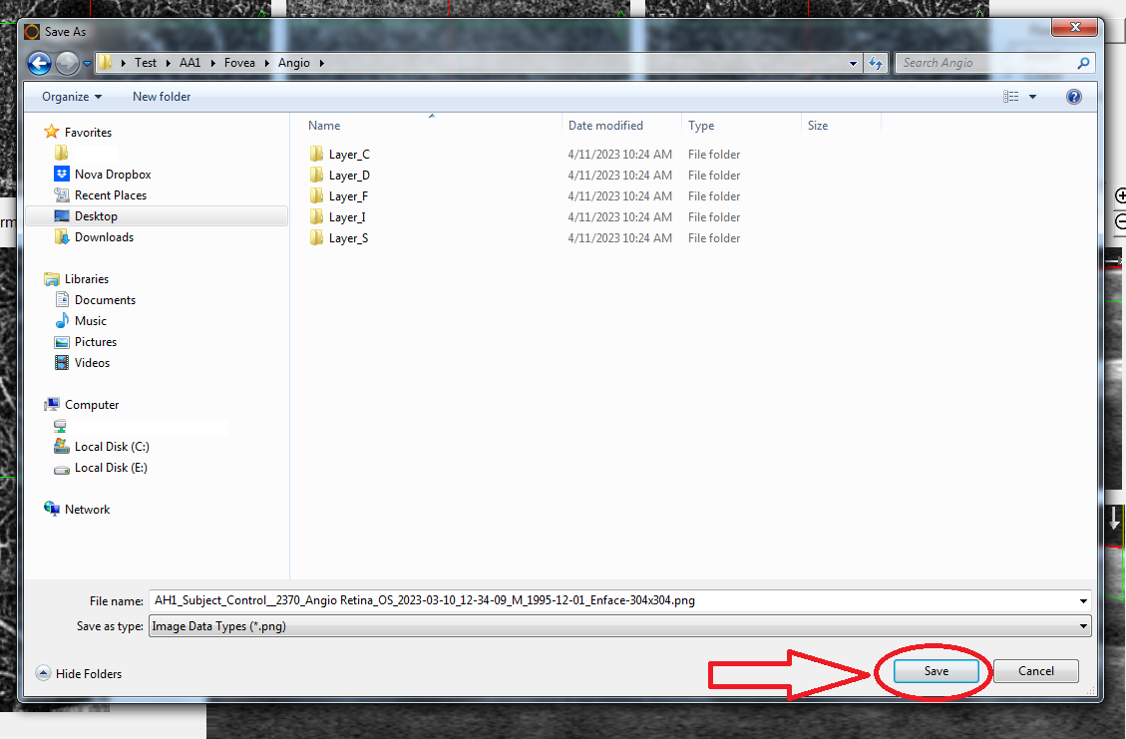
A window should open, locate the folder we made earlier (the OCTA folder we copied and renamed). This is the angio layer and we will save these images in the angio folder so CLICK RESEARCH ID-> FOVEA -> ANGIO. The window should appear like below. CLICK “SAVE”

Slide 27
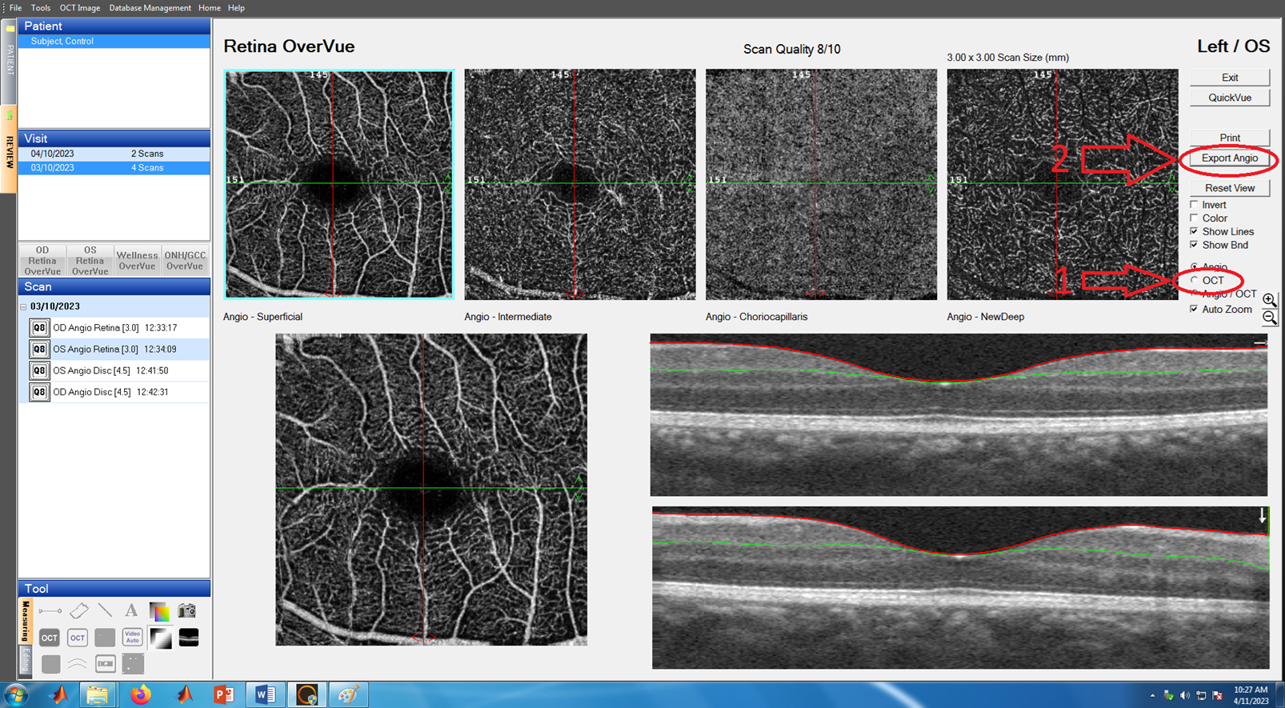
We also want the Enface view. CLICK “OCT” and then CLICK “EXPORT ANGIO”.

Slide 28
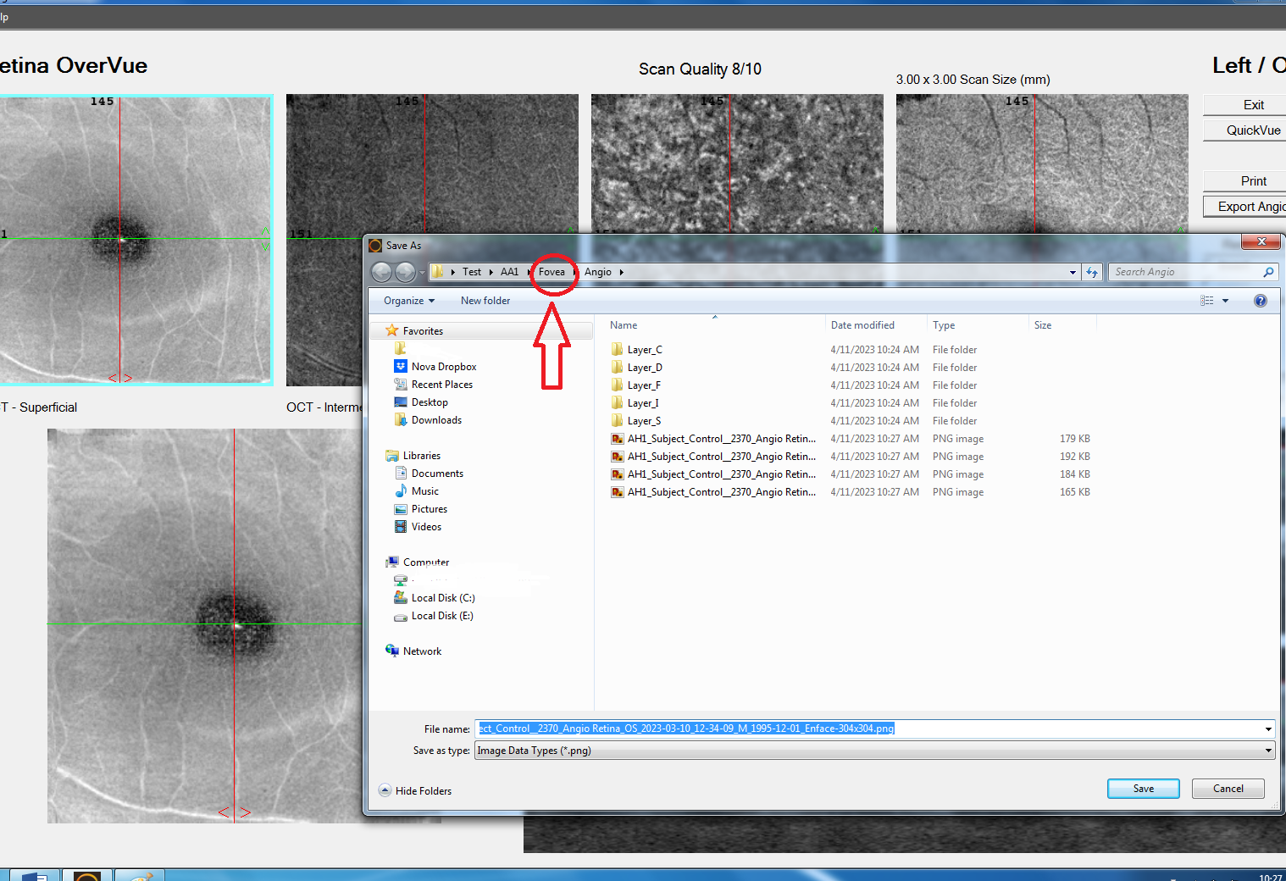
After clicking the “OCT” bullet you will see that the images are much lighter in shade. These are the enface view. We will save these in the Enface folder. After clicking “EXPORT ANGIO” The previously saved angio files will now appear with the F,S,I,D,C folders. CLICK “FOVEA”.

Slide 29
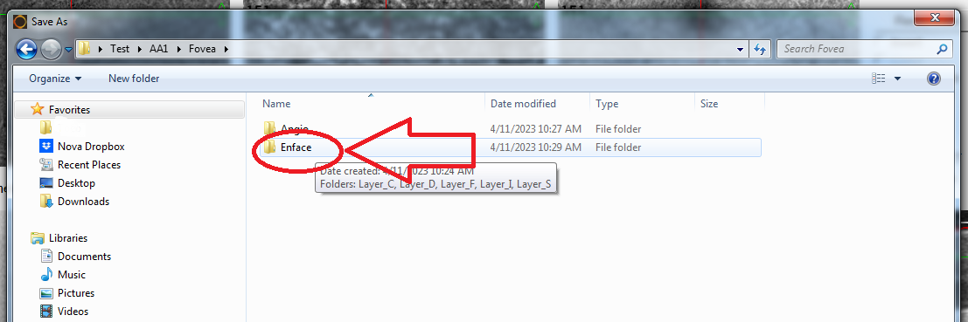
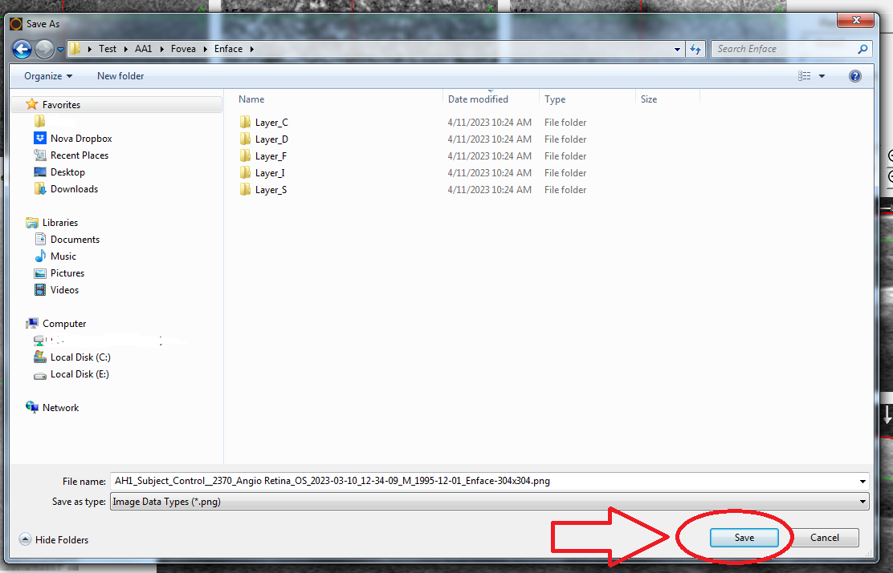
Open the ENFACE FOLDER and click “SAVE”

Slide 30
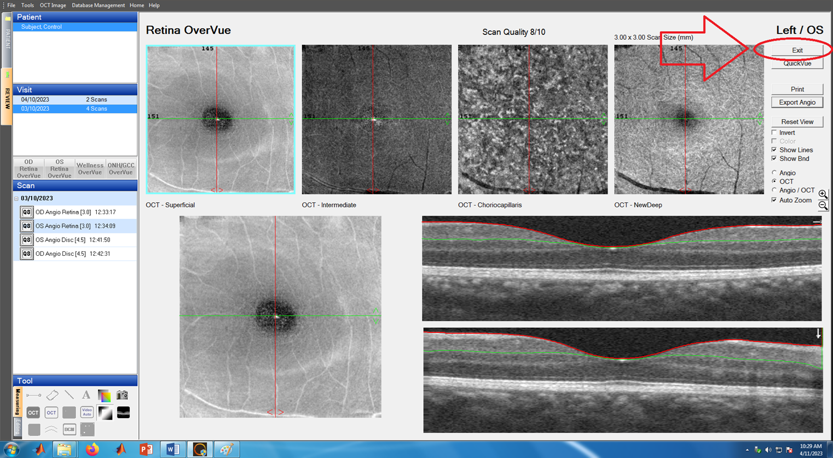
As you may have noticed in the angio and enface folders. There were only 4 images but 5 folders. For the fifth image Click “EXIT”

Slide 31
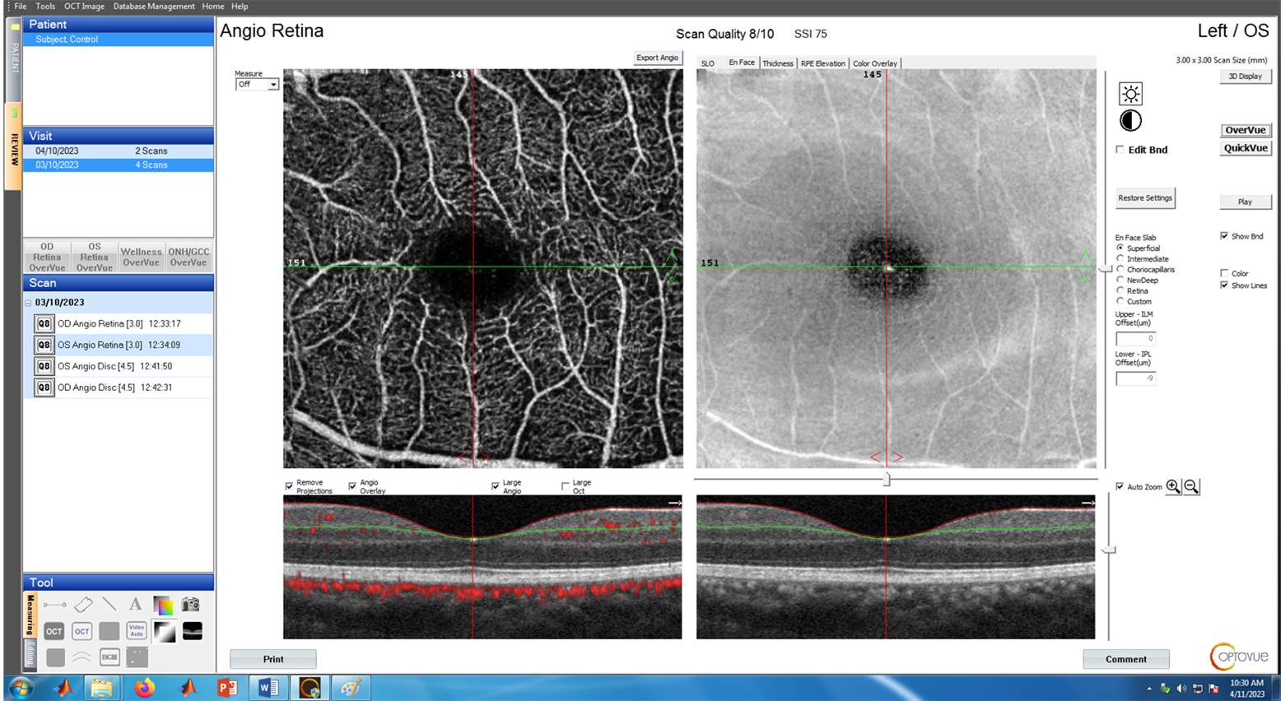
The window should be similar to this:

Slide 32
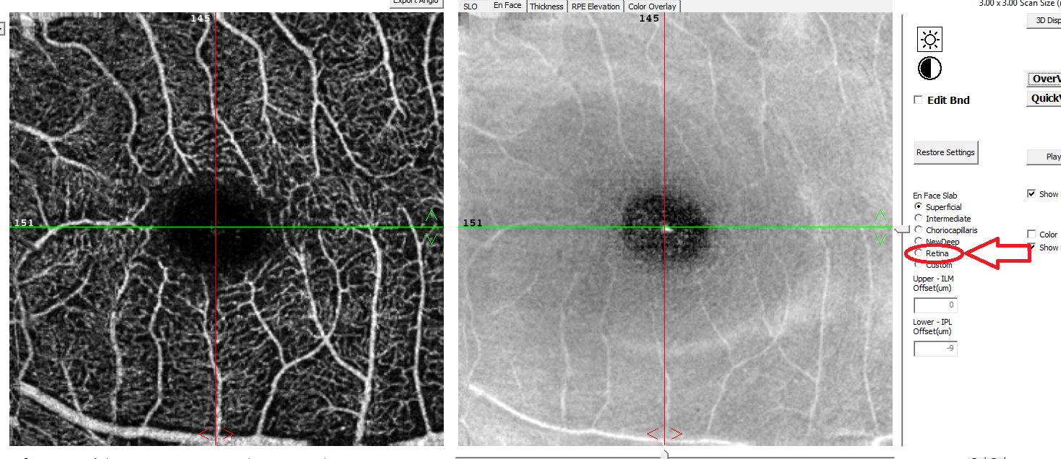
This is the full view and the fifth image we need for both the Angio and Enface views. Before you save you need to click RETINA. Not doing so will just make a copy of the superficial layer which you have from the previous steps.

Slide 33
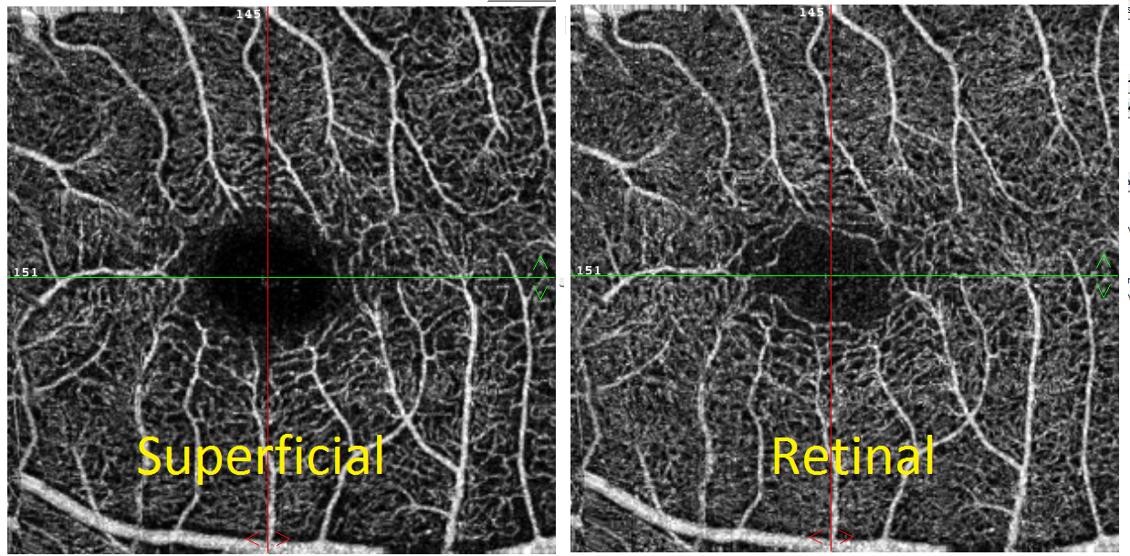
Below is both the retina and superficial. Not clicking retina will leave you with the image on the left. See the difference. Make sure to click Retina before exporting.

Slide 34
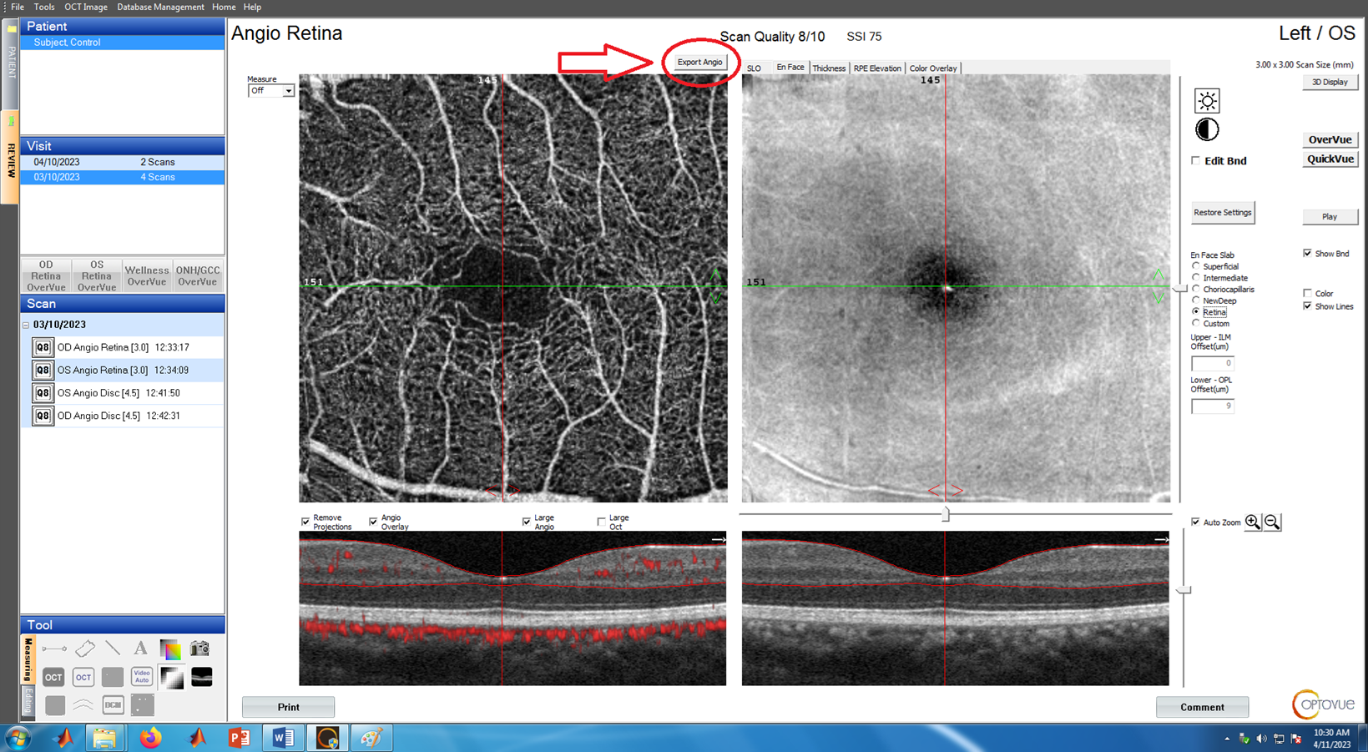
Click “EXPORT ANGIO”.

Slide 35
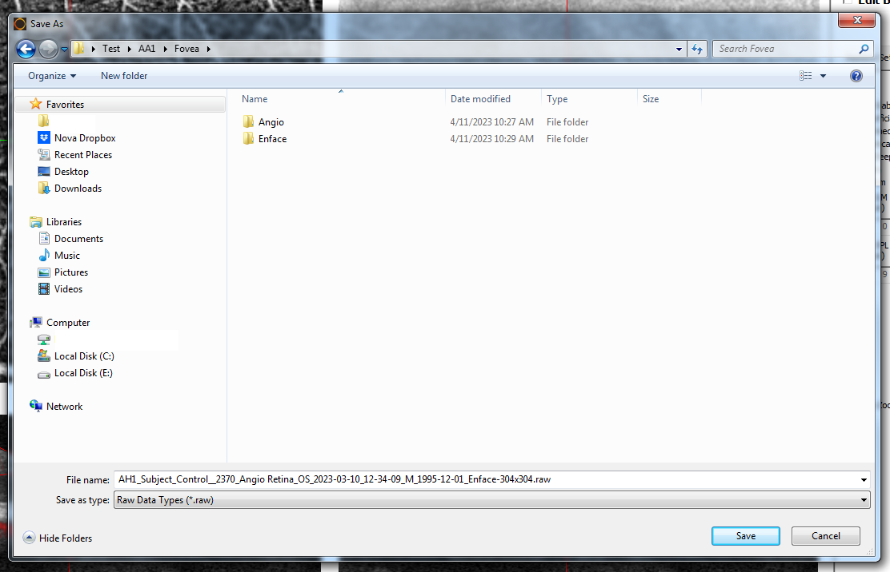
The window should open to where you saved the Enface images. Click Fovea in the address bar and save in the main FOVEA folder like below.

Slide 36
Repeat Repeat and Repeat
That ends one scan. Click the fourth scan of the session which will be the second scan after dilation if it is a Visit 1 session. Repeat the steps above so you will add 4 images in the angio folder, 4 in the enface and 2 in the main fovea folder. And keep repeating with all the images.

Slide 37
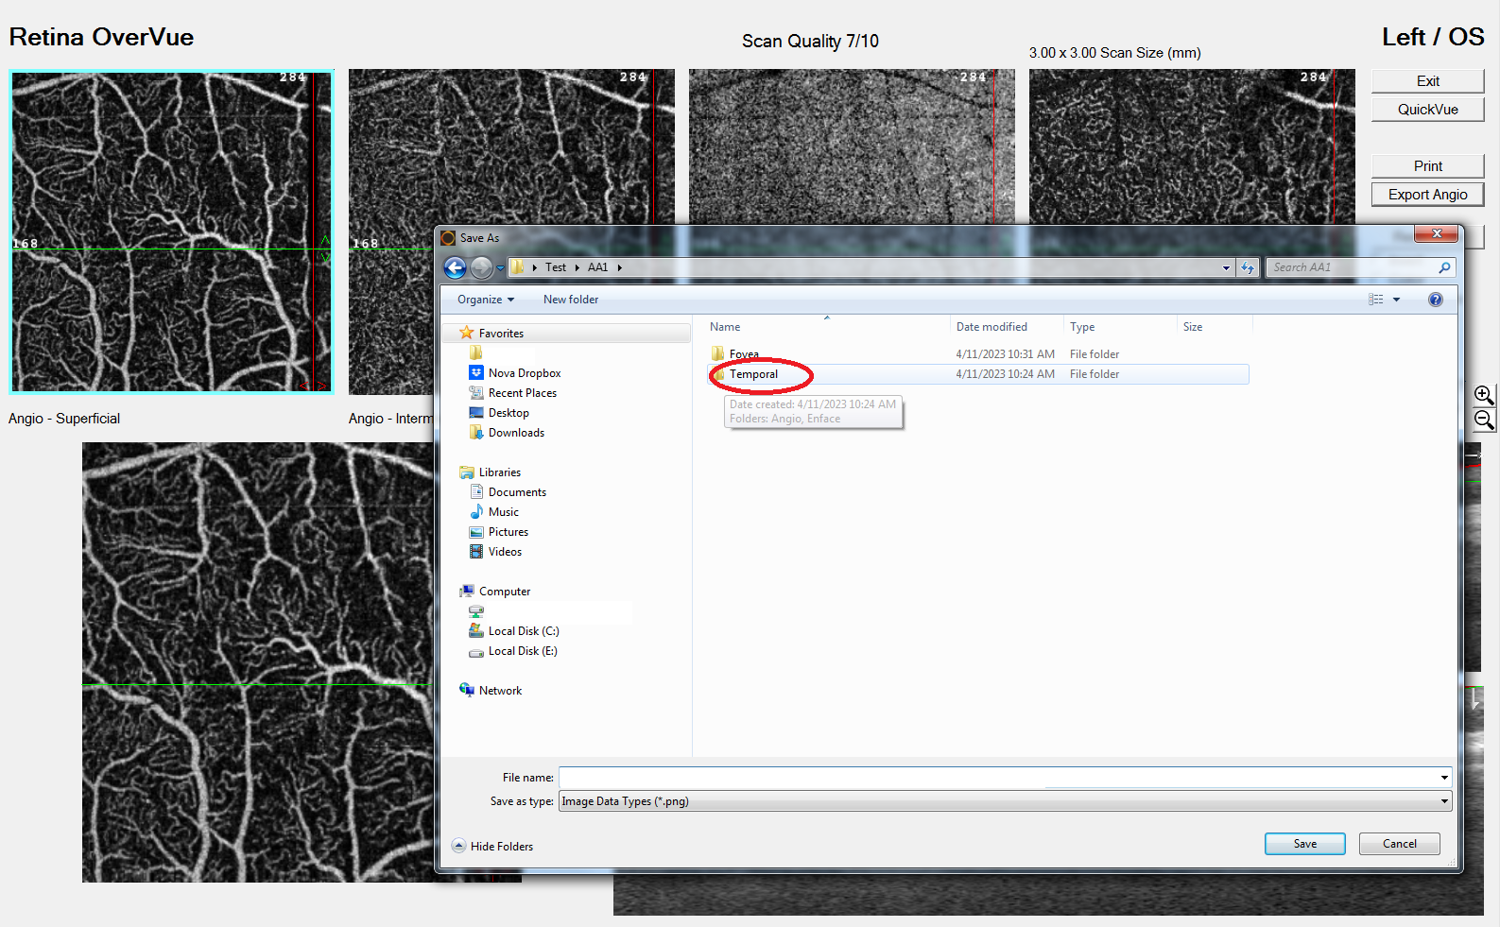
After 10-11 scans depending on the session. You will encounter the images of the temporal side. How do you know if these are temporal images? Well no fovea is a big hint. Like the image below you’ll see there's no fovea (big dark spot in the middle) If you notice too late and have already saved one or two scans. Congratulations welcome to the club. For the temporal images we will do the same thing as the Fovea images but save in the Temporal folder.

Slide 38
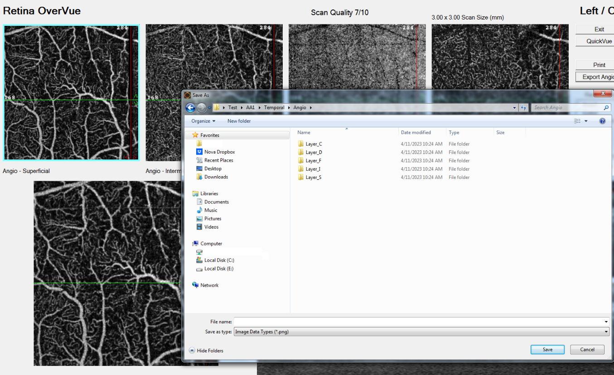
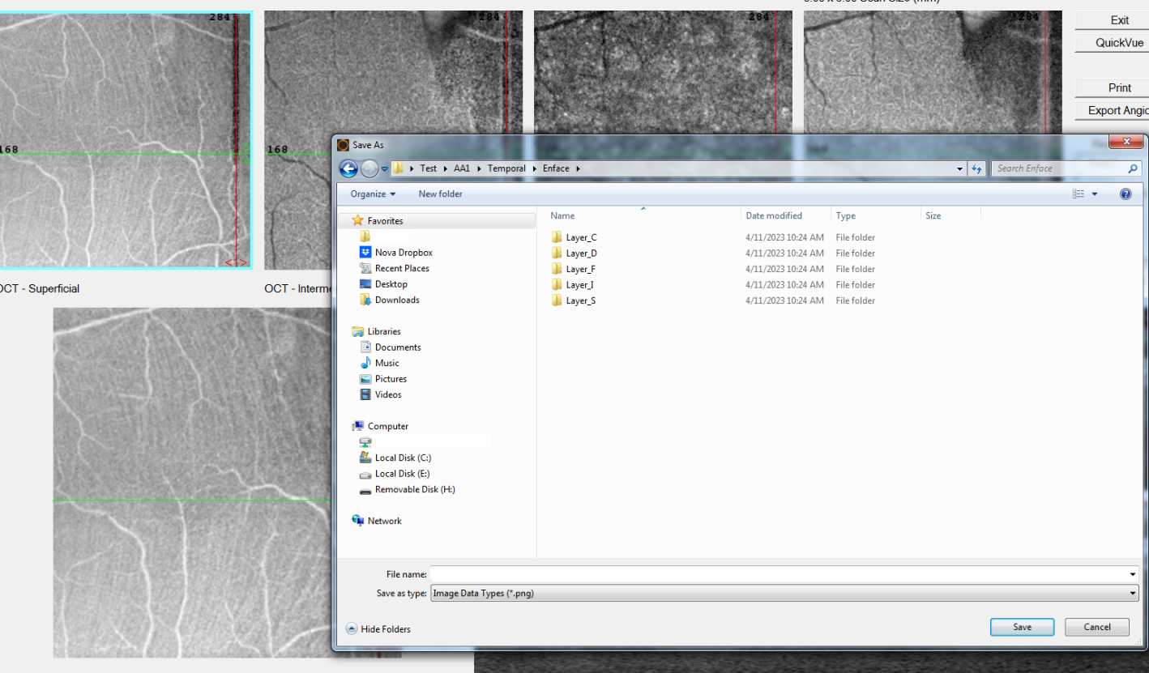
So like the Fovea images we will save the angio images in the TEMPORAL->ANGIO folder and the ENFACE images in the TEMPORAL ->ENFACE folder

Slide 39
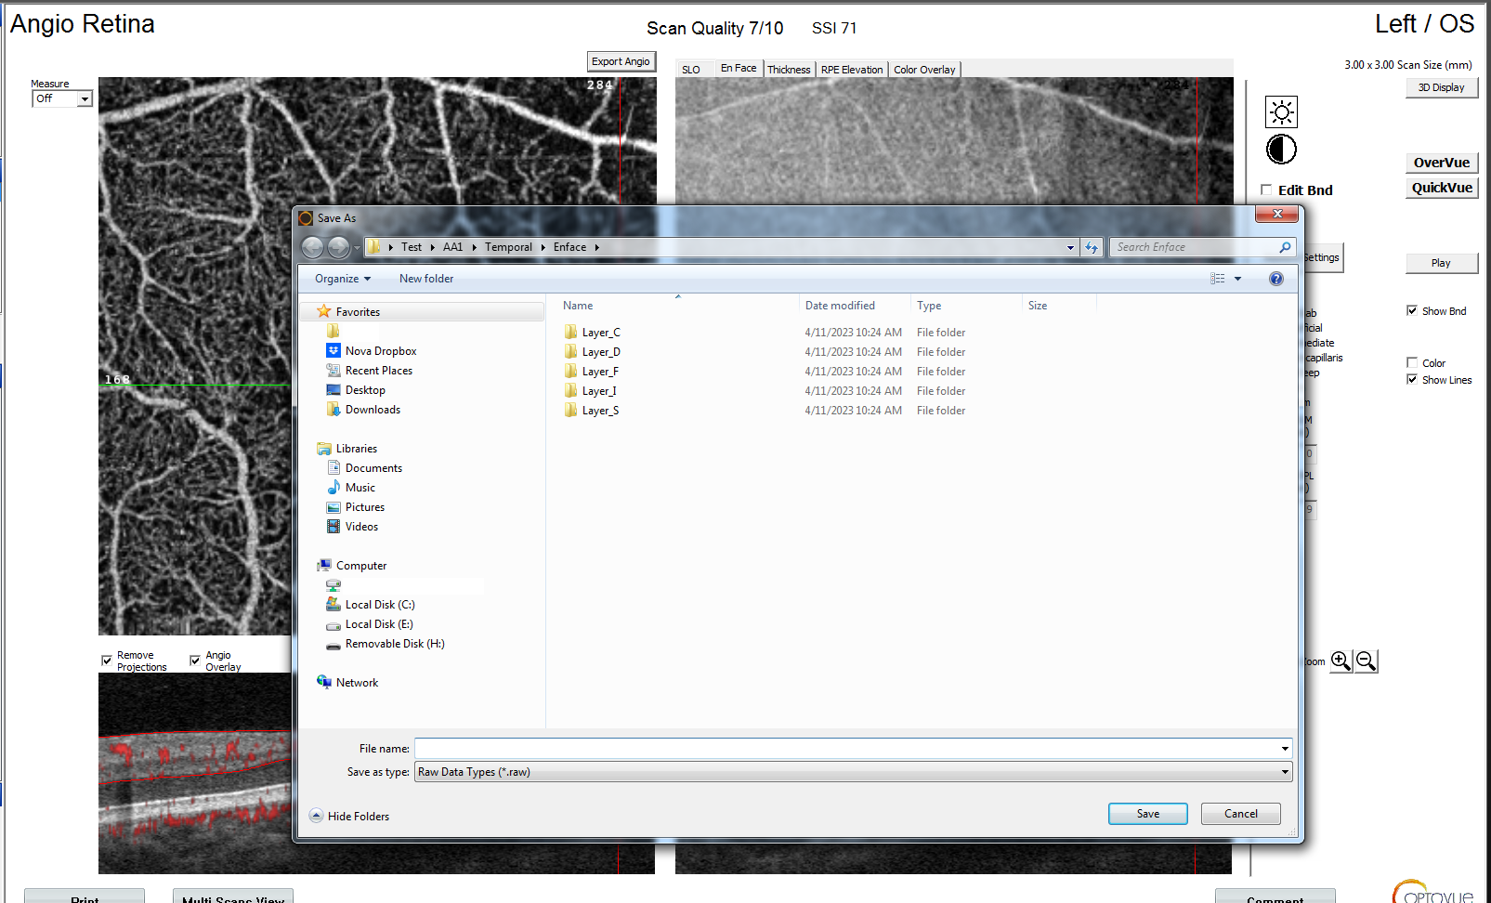
The full retina images will be saved in the main temporal folder. Make sure you click the Retina and not save the superficial layer.

Slide 40
REPEAT AND REPEAT. Until you encounter the fovea images of the second session. Save those images in the fovea folder. Exactly like mentioned before.

Slide 41
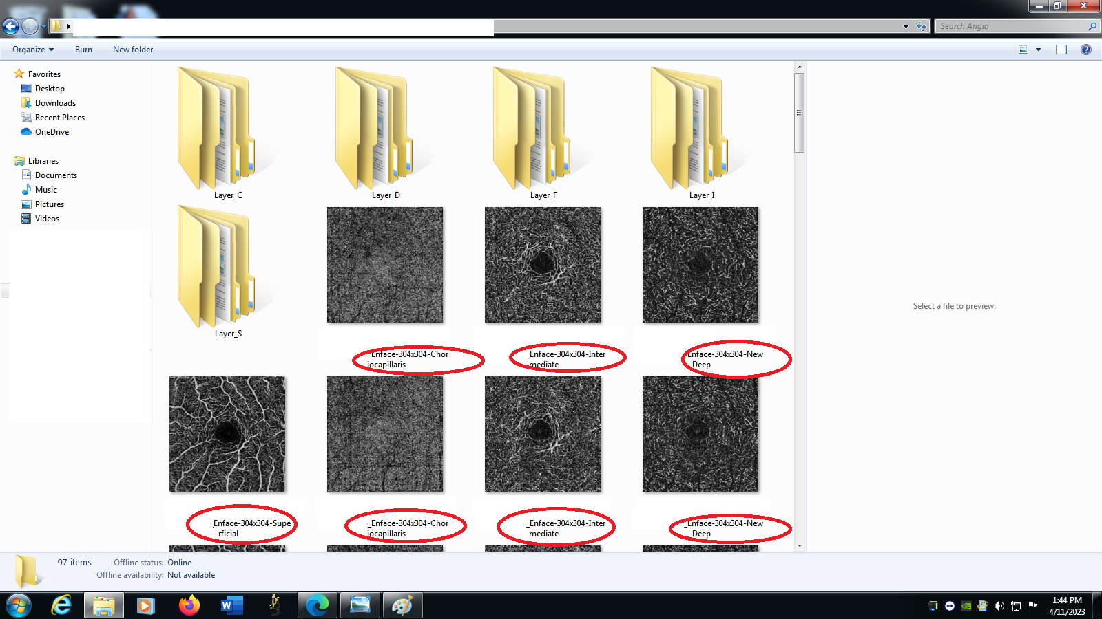
Okay now that all the images have been saved. Open the fovea folder. You will have a lot of images. These images are all different layers of the scans we took. To distinguish between you’ll notice that they’re names end with which layer they are.

Slide 42
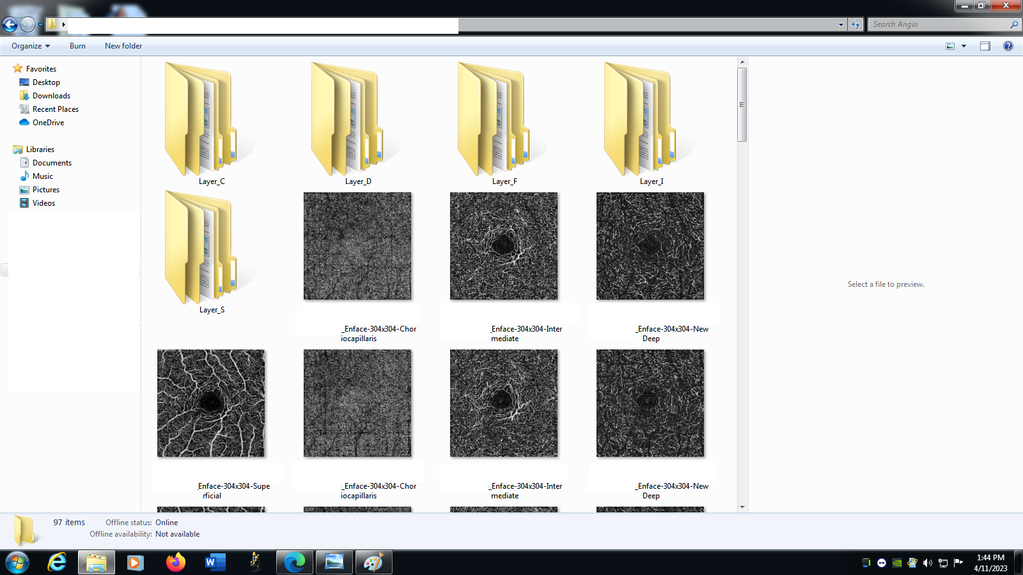
Now to start transferring the images into their respective folders use ctrl and the scroll wheel on the mouse to make it so there are 4 images per row in the window. There will be 4 Columns:
CHORIOCAPILLARIS
INTERMEDIATE
NEW DEEP
SUPERFICIAL

Slide 43
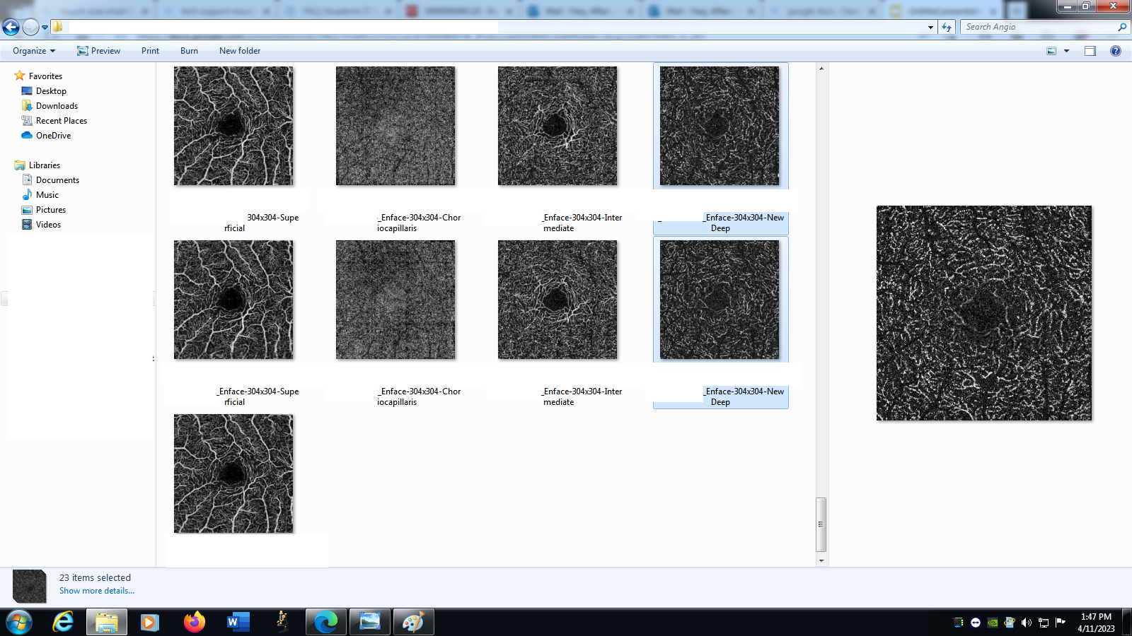
Select one column by dragging the mouse straight down one set.

Slide 44
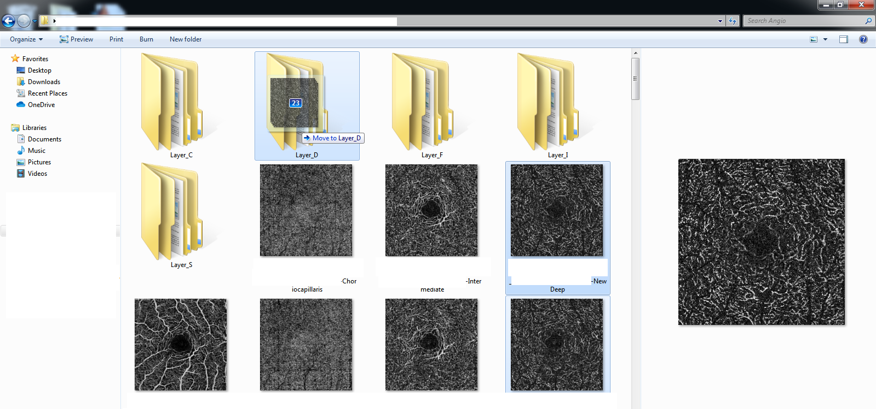
Drag the images into the respected folder. So
FOLDER_S FOR SUPERFICIAL Images
FOLDER_D For NEW DEEP Images
FOLDER_I For INTERMEDIATE Images
FOLDER_C For CHORIOCAPILLARIS Images

Slide 45
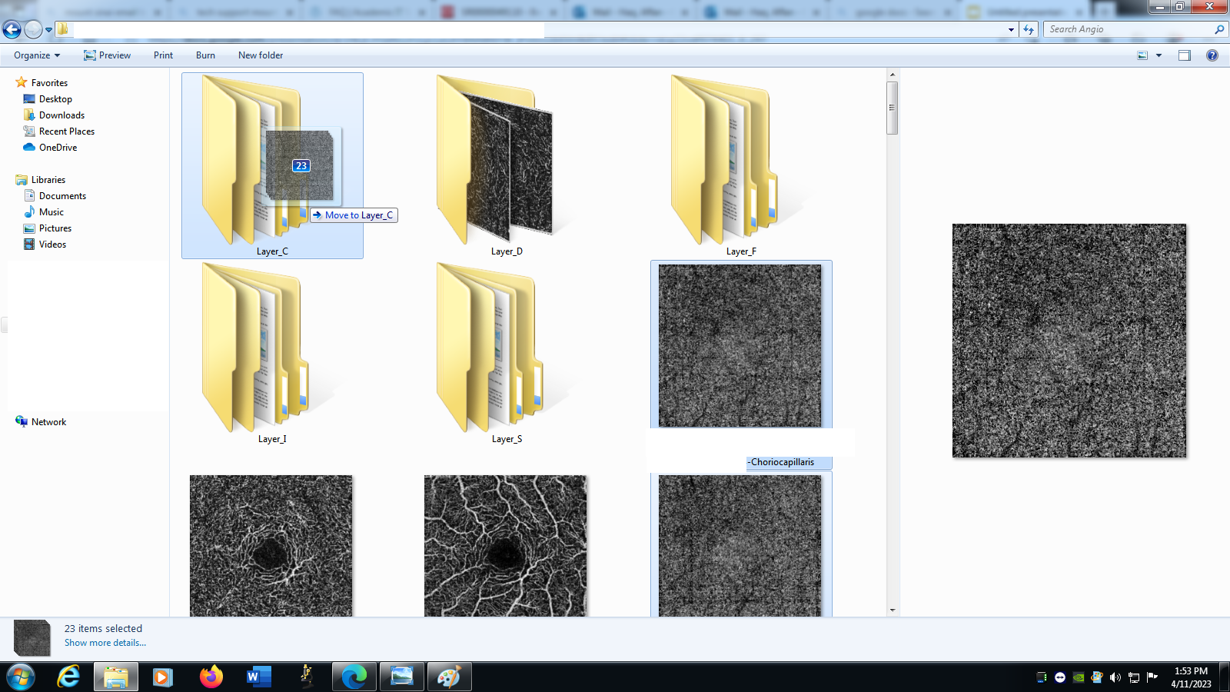
After transferring the first set, you’ll see it's not perfect columns anymore. Don't worry. Just scroll in while pressing the ctrl button and you want three rows. Then drag the next set into it’s folder. So Choriocapillaris into Folder_C in our case.

Slide 46
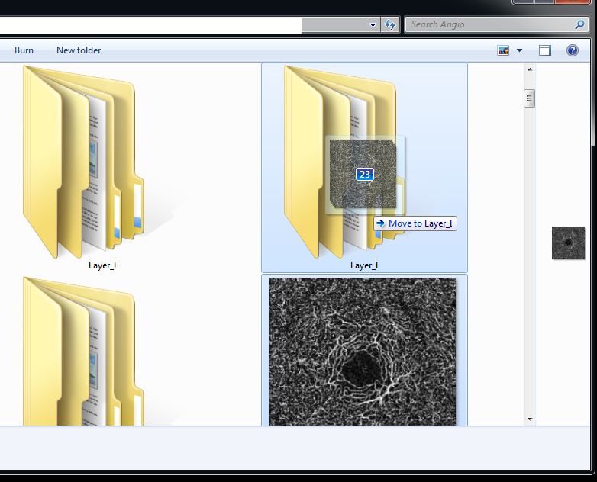
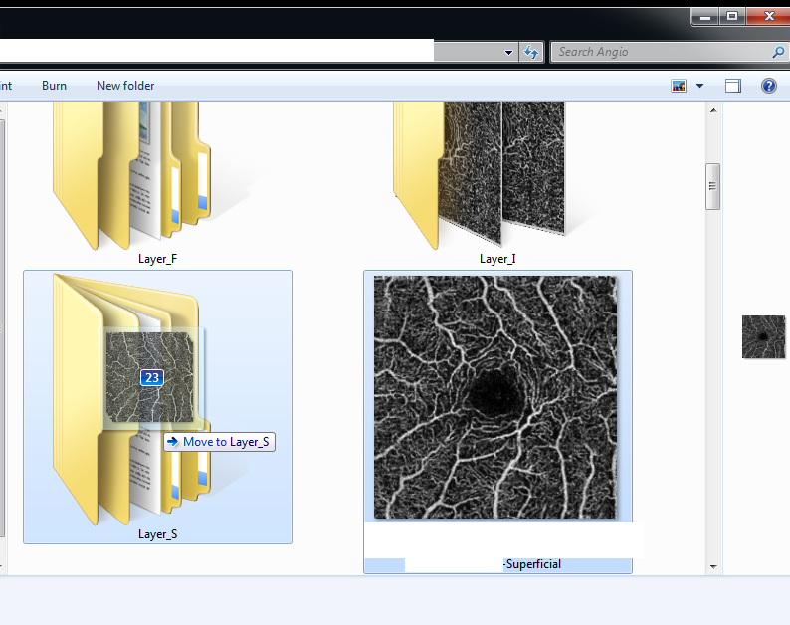
REPEAT for the other 2 layers. Repeat the process for the images in the enface folder.

Slide 47

Go back into the main fovea folder and delete the .raw files using the scroll wheel to have 3 in a row. Now you should have 2 sets of images in the fovea folder with the ANGIO and ENFACE folders. Using the scroll wheel click scale the size so you 2 in a row. Left click drag the images that appear darker, these are your angio full retina images.

Slide 48


Click Cut (ctrl + x). Go into the Angio Folder and Open FOLDER_F and PASTE (ctrl + v) the images here.

Slide 49
Repeat with the Enface full images. Left click drag and CLICK Cut. Then PASTE into Folder_F (Fovea/Enface/Folder_F). That’s it you're done with the Fovea for now.
Repeat for the temporal side.
Remember
Folder_S For SUPERFICIAL
Folder_D For NEW DEEP
Folder_I For INTERMEDIATE
Folder_C For CHORIOCAPILLARIS
And cut and paste into Folder_F for both Angio and Enface. Make sure your Full images are correct and you haven't accidentally exported without clicking Retina.

Slide 50
Now you want to make sure you have the same number of images in each folder in both temporal and fovea folders. Once you have confirmed they are the same in each folder. You also want to make sure you have the correct number of images compared to how many scans you took. So in our case we took 45 scans and we have 23 images in the fovea and 22 in the temporal. So that checks out and you can move on.

Slide 51


Adding the Axial Length File into the Folder
One of the last things to be done before uploading into the unprocessed folder will be adding the Axial Length File into the Folder. Find the .txt document named axial lengh.txt on the desktop. Copy paste this document into your folder like below

Slide 52

In the text file you will need to input which eye was scanned, so (OS) for the Left eye or (OD) for the Right eye.
Below that you will put in the axial length.
Close the window after saving and now you have a complete folder with the correct number of images in each folder and an axial length file. Ready to be uploaded to the Server/Dropbox/Hard drive that will be used for the study.

Slide 53

Once uploaded you are done with the 5 layer Processing

